Slide 1

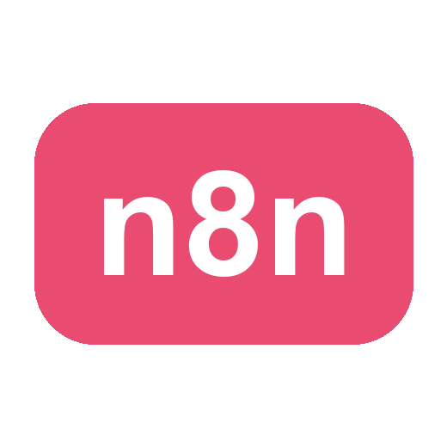
LEARNER GUIDE · COURSE SLIDES
Agentic AI Automation with n8n
WSQ Course Code: TGS-2023035977
Conducted by Tertiary Infotech Academy Pte Ltd · UEN 201200696W
Version v48 · 17 Oct 2026
© 2026 Tertiary Infotech Academy Pte Ltd. All rights reserved. · www.tertiarycourses.com.sg

Slide 2
TRAQOM · SSG DIGITAL ATTENDANCE
Digital Attendance (Mandatory)
• It is mandatory to take the AM, PM and Assessment digital attendance for WSQ-funded courses.
• The trainer/administrator will display the digital attendance QR code generated from the SSG portal.
• Scan the QR code with your mobile phone camera and submit your attendance.
• A minimum of 75% attendance is required to be eligible for assessment and funding.
Agentic AI Automation with n8n · TGS-2023035977
© 2026 Tertiary Infotech Academy Pte Ltd
1

Slide 3
YOUR TRAINER · GENERAL
About the Trainer
NAME
____________________________________________
?
TITLE / DESIGNATION
____________________________________________
QUALIFICATIONS
____________________________________________
Your Trainer
AREAS OF EXPERTISE
____________________________________________
General Trainer template —
to be completed by the trainer
TRAINING & INDUSTRY EXPERIENCE
____________________________________________
CONTACT
____________________________________________
Agentic AI Automation with n8n · TGS-2023035977
© 2026 Tertiary Infotech Academy Pte Ltd
2

Slide 4
YOUR TRAINER
About the Trainer
ROLE
Principal Trainer, Tertiary Infotech Academy Pte. Ltd.
AA
QUALIFICATIONS
PhD — specialises in AI, automation and software engineering.
Dr. Alfred Ang
DELIVERS
WSQ courses on AI agents, automation (n8n) and app development.
Principal Trainer
Tertiary Infotech Academy Pte. Ltd.
FOUNDER
Founder and lead instructor at Tertiary Infotech / Tertiary Courses.
Agentic AI Automation with n8n · TGS-2023035977
© 2026 Tertiary Infotech Academy Pte Ltd
3

Slide 5
ICE-BREAKER
Let's Know Each Other
• Your name and organisation / role.
• Your experience with automation or AI tools (if any).
• What you want to automate after this course.
Agentic AI Automation with n8n · TGS-2023035977
© 2026 Tertiary Infotech Academy Pte Ltd
4

Slide 6
HOUSEKEEPING
Ground Rules
Set your mobile phone to silent mode.
Participate actively — no question is too small.
1
2
Mutual respect: agree to disagree.
One conversation at a time.
3
4
Be punctual; return from breaks on time.
75% attendance is required.
5
6
Agentic AI Automation with n8n · TGS-2023035977
© 2026 Tertiary Infotech Academy Pte Ltd
5

Slide 7

COURSE PORTAL
Login to LMS and Download Course Material
Log in at lms-tms.tertiaryinfotech.com with your registered email + the OTP from your inbox, then download the slides and Learner Guide.
Agentic AI Automation with n8n · TGS-2023035977
© 2026 Tertiary Infotech Academy Pte Ltd
6

Slide 8
COURSE PORTAL · STEPS
Download Course Material
1
2
3
4
5
▶
▶
▶
▶
Go to lms-tms.
tertiaryinfotech.com
Enter your registered email and click Send OTP
Key in the one-time password from your inbox
Open this course and download the slides + Learner Guide
Keep them open — the assessment is open book
Agentic AI Automation with n8n · TGS-2023035977
© 2026 Tertiary Infotech Academy Pte Ltd
7

Slide 9
GET THE WORKFLOWS
Download the Course Flows (GitHub)
1
Open the course repo: github.com/tertiarycourses/TGS-2023035977-Agentic-AI-Automation-with-n8n
2
Code ▾ → Download ZIP (or git clone) — all workflows are in the labs/ folder.
3
In n8n: Workflows → Add workflow → ... → Import from File → pick the activity .json.
4
After importing, re-select YOUR OWN credentials on each node, then Save & Publish.
Agentic AI Automation with n8n · TGS-2023035977
© 2026 Tertiary Infotech Academy Pte Ltd
8

Slide 10
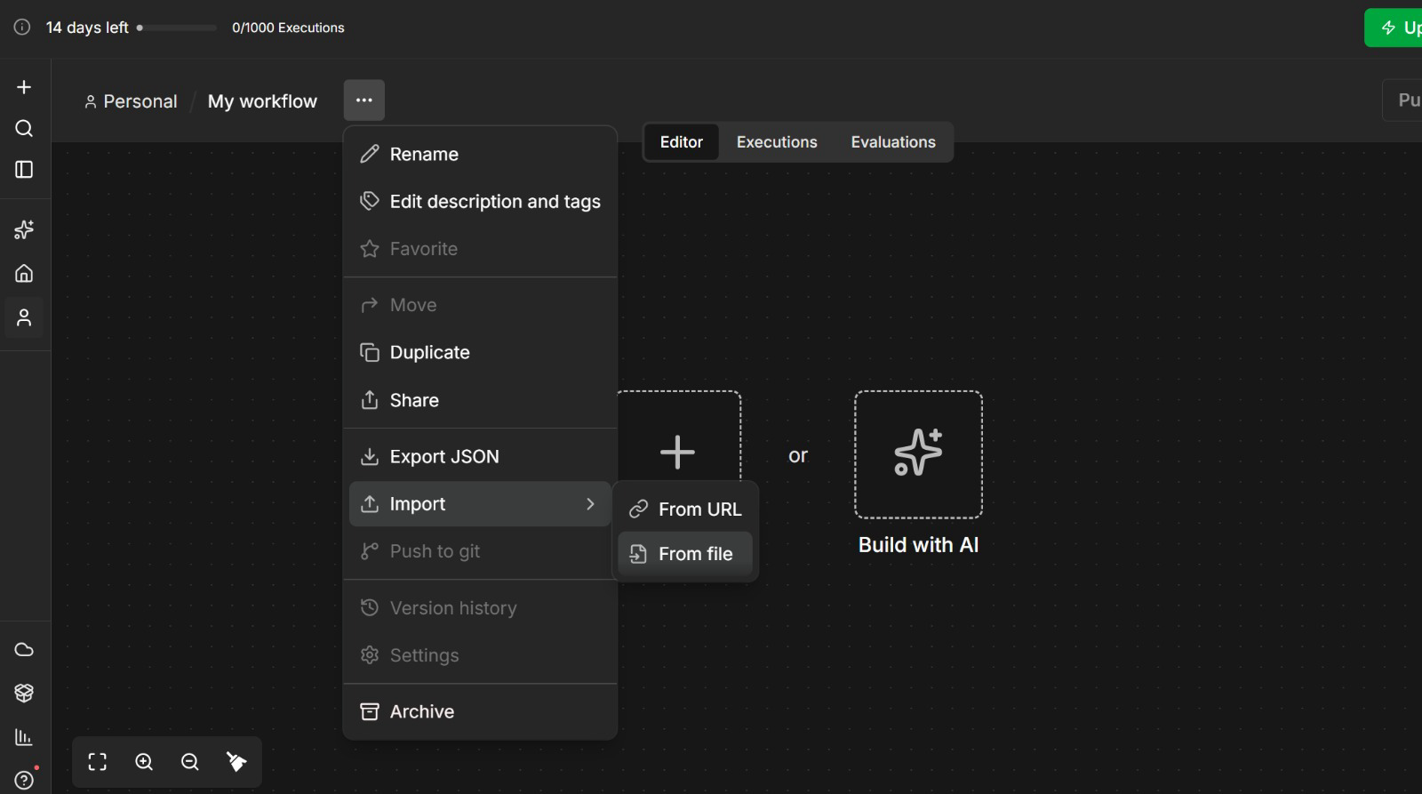
GET THE WORKFLOWS
Import a Workflow from File
Create a NEW workflow, open the '...' menu → Import → From File and pick the activity .json, so your own build is not overwritten.
Agentic AI Automation with n8n · TGS-2023035977
© 2026 Tertiary Infotech Academy Pte Ltd
9

Slide 11
SCHEDULE
Lesson Plan — 3 Days, 9:30am–6:30pm
Day 1 — Automate, then add AI
Day 2 — Connect it to the world
Day 3 — Govern, then prove it
• Topic 1: n8n basics — triggers, actions, data
• Activities 1, 2, 3a, 3b — forms, storage, logic
• Topic 2: AI Agents — model · memory · tools · instructions
• Activities 4a, 4b — Telegram agent + Data Table tool
• Topic 3: Webhooks — Activity 5 (website chatbot)
• Topic 4: APIs & HTTP — Activity 6 (day-trading agent)
• Topic 5: RAG — Activities 7a, 7b (grounded agents)
• Topic 6: Security — human-in-the-loop + guardrails
• Activities 8a, 8b, 8c — the HR Service Portal
• Topic 7: Mini capstone + presentations
• Written Assessment (SAQ) 1 hr · Practical (PP) 1 hr
Each day runs 9:30am–6:30pm — 8 instructional hours with a 1-hour lunch; tea breaks counted within.
Agentic AI Automation with n8n · TGS-2023035977
© 2026 Tertiary Infotech Academy Pte Ltd
10

Slide 12
WHAT YOU'LL ACHIEVE
Learning Outcomes
1
LO1: Build automated workflows in n8n using triggers, actions, nodes and flows.
2
LO2: Design AI agents with LLMs, memory and tools, triggered from chat / Telegram.
3
LO3: Apply Retrieval-Augmented Generation (RAG) to ground agents in your documents.
4
LO4: Integrate external systems via webhooks, APIs and HTTP requests.
5
LO5: Apply human-in-the-loop and guardrails to secure agentic automations.
Agentic AI Automation with n8n · TGS-2023035977
© 2026 Tertiary Infotech Academy Pte Ltd
11

Slide 13
COURSE JOURNEY
Twelve Connected Labs
1
Act 1 — Form → Email: your first automation, on a real flyer.
2
Act 2 — Data Table: store every submission, not just forward it.
3
Act 3a/3b — IF logic: route Yes/No to storage or a thank-you.
4
Act 4a — Telegram HR policy agent, built with n8n Assistant.
5
Act 4b — Agent + tool: answers HR questions from a Data Table.
6
Act 5 — Webhook: your agent behind a public website chatbot.
7
Act 6 — APIs: live candles + news → Buy / Sell / Hold calls.
8
Act 7a — RAG: upload a PDF, ask the bot in Telegram.
9
Act 7b — RAG at scale: 20 brochures in a real vector DB.
10
Act 8a–8c — HR portal: approval gate, dashboard, guardrails.
11
Capstone — design and demo your own end-to-end automation.
Agentic AI Automation with n8n · TGS-2023035977
© 2026 Tertiary Infotech Academy Pte Ltd
12

Slide 14
BEFORE THE ASSESSMENT
Briefing for Assessment
• Place phones and other materials under the table or on the floor.
• No photos or recording of assessment scripts.
• No discussion during the assessment.
• Use a black/blue pen for hard-copy assessments.
• No liquid paper / correction tape.
• Scripts are collected when time is up.
Agentic AI Automation with n8n · TGS-2023035977
© 2026 Tertiary Infotech Academy Pte Ltd
13

Slide 15
FINAL ASSESSMENT
Assessment
• Written Assessment (SAQ) — 1 hour.
• Practical Performance (PP) — 1 hour.
• Format: Open Book — slides, Learner Guide and approved materials only.
• A mini capstone project is presented on Day 3.
• An appeal process is available if required.
Agentic AI Automation with n8n · TGS-2023035977
© 2026 Tertiary Infotech Academy Pte Ltd
14

Slide 16
ON ASSESSMENT DAY
Assessment Flow
1
2
3
4
5
▶
▶
▶
▶
TRAQOM survey — scan the QR code on the LMS
Assessment digital attendance — scan the SSG QR
Sit WA (SAQ) then PP — open book
Submit your answers on the LMS
Sign the Assessment Summary Record
Agentic AI Automation with n8n · TGS-2023035977
© 2026 Tertiary Infotech Academy Pte Ltd
15

Slide 17
01
TOPIC 1
Workflow Automation with n8n
Why agentic AI · workflow first vs agent first · AI security · what n8n is · sign-in and free AI credits · n8n Assistant · triggers · data nodes
Applied in Activities 1, 2, 3a and 3b
Agentic AI Automation with n8n · TGS-2023035977
© 2026 Tertiary Infotech Academy Pte Ltd
16

Slide 18
TOPIC 1 · A BRIEF HISTORY OF AI
A Brief History of AI, 2023–2026
Each year moved the skill that matters — from the words you type to the system you build.
Prompt Engineering
2023
Context Engineering
2024
Harness Engineering
2025
AI Agents
2026
▶
▶
▶
Wording the prompt
Curating the context
Building the harness
Agents at work
ChatGPT goes mainstream. Results depend on how well you word the prompt.
Models call tools and MCP launches. Results depend on the documents, data and tools you supply.
Claude Code and Codex: systems that plan, act and check their own work in a loop.
Always-on agents work 24/7 — OpenClaw, Hermes Agent and agent teams take on whole jobs.
From wording one prompt → curating context → engineering the harness → AI agents that work around the clock.
Agentic AI Automation with n8n · TGS-2023035977
© 2026 Tertiary Infotech Academy Pte Ltd
17

Slide 19
TOPIC 1 · GENERATIVE VS AGENTIC AI
Generative AI vs Agentic AI
GENERATIVE AI — answers
AGENTIC AI — acts
• You ask; it writes one answer.
• No memory of your systems, no actions.
• Quality depends on what you paste into the prompt.
• Example: ChatGPT summarising a document.
• Works toward a goal, not just one reply.
• Calls tools: looks up data, calls APIs, writes records.
• Holds a conversation with memory.
• Example: a bot that checks the Employees table and answers.
Generative AI produces content. Agentic AI decides and does — which is why it needs governance.
Agentic AI Automation with n8n · TGS-2023035977
© 2026 Tertiary Infotech Academy Pte Ltd
18

Slide 20
TOPIC 1 · AGENTIC AI VS AI AGENTS
Agentic AI vs AI Agents
Agentic AI — the broad category
AI Agents — always-on agentic AI
• Any AI system that pursues a goal over many steps: plans, acts through tools, checks the result
• Usually started by a person or a trigger, and stops when the task is done
• Built as a workflow with AI steps, or around an LLM loop
• Includes the orchestration, guardrails and human approvals
• Examples: a Claude Code or Codex session; an n8n workflow with AI steps
• A special type of agentic AI system that exists 24/7
• Usually installed in the cloud, so it serves all the time — no laptop needs to be open
• Waits for events — messages, emails, webhooks, schedules — and acts on them around the clock
• Keeps its memory across conversations and days
• Examples: OpenClaw, Hermes Agent, an n8n agent on a cloud instance behind a webhook
Every AI agent is agentic AI, but not every agentic AI is an AI agent — an AI agent is always on, serving 24/7.
Agentic AI Automation with n8n · TGS-2023035977
© 2026 Tertiary Infotech Academy Pte Ltd
19

Slide 21
TOPIC 1 · WORKFLOW FIRST VS AGENT FIRST
Workflow First vs Agent First
Workflow first evolves rule-based (RPA) automation: the workflow owns the path, and its steps can be AI or AI agents, as in n8n.
Workflow First
Agent First
Who decides the path
The workflow — steps may be AI nodes or AI Agent nodes
The agent decides the steps and tools at run time
Behaviour
Deterministic — same input, same path, every time
Probabilistic — the path can change between runs
Efficiency
More effort to design every branch up front
Efficient — one instruction replaces many hand-built branches
Reliability & testing
Easy to test, debug and certify step by step
Harder to test; edge cases surface in production
Cost & speed
An LLM call only where needed — cheap and fast
An LLM call at every step — more tokens, more latency
Best for
Repeatable, regulated, high-volume processes
Open-ended tasks with unpredictable inputs
Source: n8n, In The Loop 2026 — opening keynote and product direction (youtube.com/watch?v=KQRe5UurLQ0)
Workflow first is more deterministic; agent first is more efficient. Companies make as much deterministic as they can.
Agentic AI Automation with n8n · TGS-2023035977
© 2026 Tertiary Infotech Academy Pte Ltd
20

Slide 22
TOPIC 1 · THE MODERN VIEW
The Trend: AI-Assisted Workflow Creation
AI-powered coding has flipped the trade-off — the agent's efficiency goes into BUILDING the workflow, not running it.
Describe
the process in plain English
n8n Assistant
or Claude Code / Codex drafts it
You review
test and approve it
Workflow runs
deterministic and logged
AI and agent nodes
where judgement is needed
▶
▶
▶
▶
1
Companies want determinism
2
AI coding made it cheap
3
The best of both
Reliability, compliance and audit push businesses to make as much of a process deterministic as possible.
n8n Assistant, Claude Code and Codex are AI agents themselves — they make designing, building and changing workflows fast and cheap.
An AI agent BUILDS the workflow; a deterministic workflow RUNS the process, with AI and AI Agent nodes where judgement is needed.
The trend: AI-assisted workflow creation — the AI builds the workflow, and the workflow runs the business process.
Agentic AI Automation with n8n · TGS-2023035977
© 2026 Tertiary Infotech Academy Pte Ltd
21

Slide 23
TOPIC 1 · COMPLEXITY VS CUSTOMISATION
Where AI Agent Platforms Sit
Three tiers — and AI now helps build at every one of them. This course teaches the middle one.
1
No-code
2
Low-code · n8n
3
Full-code
HOW YOU BUILD
Drag and drop in a fully visual builder.
CUSTOMISATION
Lowest. Fastest route to a working agent, least control over the internals.
HOW YOU BUILD
AI-assisted: n8n Assistant, Claude Code or Codex drafts the workflow on a visual canvas.
CODE WHEN NEEDED
Add JavaScript or Python in a Code node where a built-in node is not enough.
CUSTOMISATION
High. 400+ integrations, self-host or cloud. This course's platform.
HOW YOU BUILD
AI generates the code — Claude Code or Codex write it, instead of coding manually.
CUSTOMISATION
Highest — the most customisable tier. SDKs and frameworks such as LangChain, with real engineering effort to test and run.
Less control, less effort · more customisation, more engineering effort →
AI drafts the workflow in low-code and writes the code in full-code. n8n: analysts build it, engineers extend it.
Agentic AI Automation with n8n · TGS-2023035977
© 2026 Tertiary Infotech Academy Pte Ltd
22

Slide 24
TOPIC 1 · WHY ORGANISATIONS ADOPT IT
Business Value of Workflow-First Agentic Automation
The modern view: what a business gains when AI builds the workflow and the workflow runs the process.
1
Reliable and predictable
2
Secure by design
3
Auditable end to end
The same input follows the same path every time, so the process can be tested and trusted like software.
Each step holds only the data and credentials it needs; risky actions wait at an approval gate.
Every run is logged node by node — you can explain, replay and correct any decision.
4
Lower running cost
5
Faster to build and change
6
Scale around the clock
Deterministic steps cost nothing in tokens; the LLM is called only where judgement is needed.
n8n Assistant, Claude Code and Codex draft the workflow in minutes; your team reviews, tests and owns it.
Triggers respond in real time, 24/7 — ten times the volume costs compute, not ten more hires.
AI where judgement is needed, workflow everywhere else — reliability you can audit, at a cost you can predict.
Agentic AI Automation with n8n · TGS-2023035977
© 2026 Tertiary Infotech Academy Pte Ltd
23

Slide 25
TOPIC 1 · USE CASES
Where Agentic Automation Is Used
The same pattern — trigger, agent, tools, oversight — recurs across every function.
1
Customer service
2
Finance & accounting
3
Risk & compliance
Answer enquiries from your own documents, capture leads, and escalate what needs a person.
Invoice processing, bank reconciliation, accounts-payable routing and exception handling.
Screen applications, flag anomalies, and route sensitive cases for human review.
4
HR & people ops
5
Sales & marketing
6
Operations
Onboarding, leave applications, policy questions and approval chains.
Lead qualification, follow-up sequencing, CRM enrichment and content drafting.
Order processing, status notifications, document generation and reporting.
Every one of these is a front door, an agent, some tools and a decision about where the human belongs.
Agentic AI Automation with n8n · TGS-2023035977
© 2026 Tertiary Infotech Academy Pte Ltd
24

Slide 26
TOPIC 1 · AI SECURITY
5 Principles of AI Security
Agents act on your behalf. These five controls keep what they can see and do safe, reviewable and accountable.
1
2
3
4
5
Data Control
Permission Control
Human in the Loop
Traceability
Right-Sized Models
WHAT AI CAN SEE
WHAT AI CAN DO
WHO APPROVES
WHAT HAPPENED
NOT THE MOST POWERFUL
Classify your data — public, internal, confidential — and decide exactly which data the AI may access.
Grant only the rights needed — read, write, edit, delete. Ask before anything destructive.
A person reviews and approves high-impact actions — payments, deletions, customer emails.
Log every prompt, tool call and change so actions can be audited, explained and rolled back.
The smallest model that does the job carries less autonomy and less risk than the most powerful one.
In n8n: scoped credentials per node, approval gates (Send and Wait), the Executions log, and a small model per AI step.
Agentic AI Automation with n8n · TGS-2023035977
© 2026 Tertiary Infotech Academy Pte Ltd
25

Slide 27
TOPIC 1 · AI SECURITY
Workflow First vs Agent First — AI Security
A fixed path limits the blast radius: a manipulated AI step cannot reach tools that are not wired to it.
Principle
Workflow First
Agent First
Data control
Each node sees only the fields wired into it
The agent can reach any data its tools expose
Permission control
Each credential is scoped to one node and one action
The agent holds every tool's rights at once
Human in the loop
The approval gate sits at a fixed, designed step
Depends on the agent choosing to ask
Traceability
Every run is logged node by node in Executions
Reasoning varies run to run and is harder to explain
Right-sized models
A small model for each narrow AI step
One capable model with broad autonomy
The path is fixed, so every control is designed in rather than hoped for — that is why regulated processes stay workflow first.
Agentic AI Automation with n8n · TGS-2023035977
© 2026 Tertiary Infotech Academy Pte Ltd
26

Slide 28
TOPIC 1 · WORKFLOW AUTOMATION
What Is n8n?
A workflow-first agentic AI platform: the workflow owns the path, and AI and AI Agent nodes sit inside it.
1
Build visually
2
Run anywhere
3
AI-native
Drag nodes onto a canvas and wire them together. 400+ app integrations, plus HTTP and Code nodes when no integration exists.
Free cloud trial at n8n.io, or self-host with Docker. Webhooks, schedules and chat triggers work the same in both.
AI Agent and LangChain nodes are built in — attach any LLM (OpenAI, Gemini, Claude), memory, tools and vector stores.
n8n is workflow-first agentic AI — deterministic workflows with AI and agents built in, on one canvas.
Agentic AI Automation with n8n · TGS-2023035977
© 2026 Tertiary Infotech Academy Pte Ltd
27

Slide 29
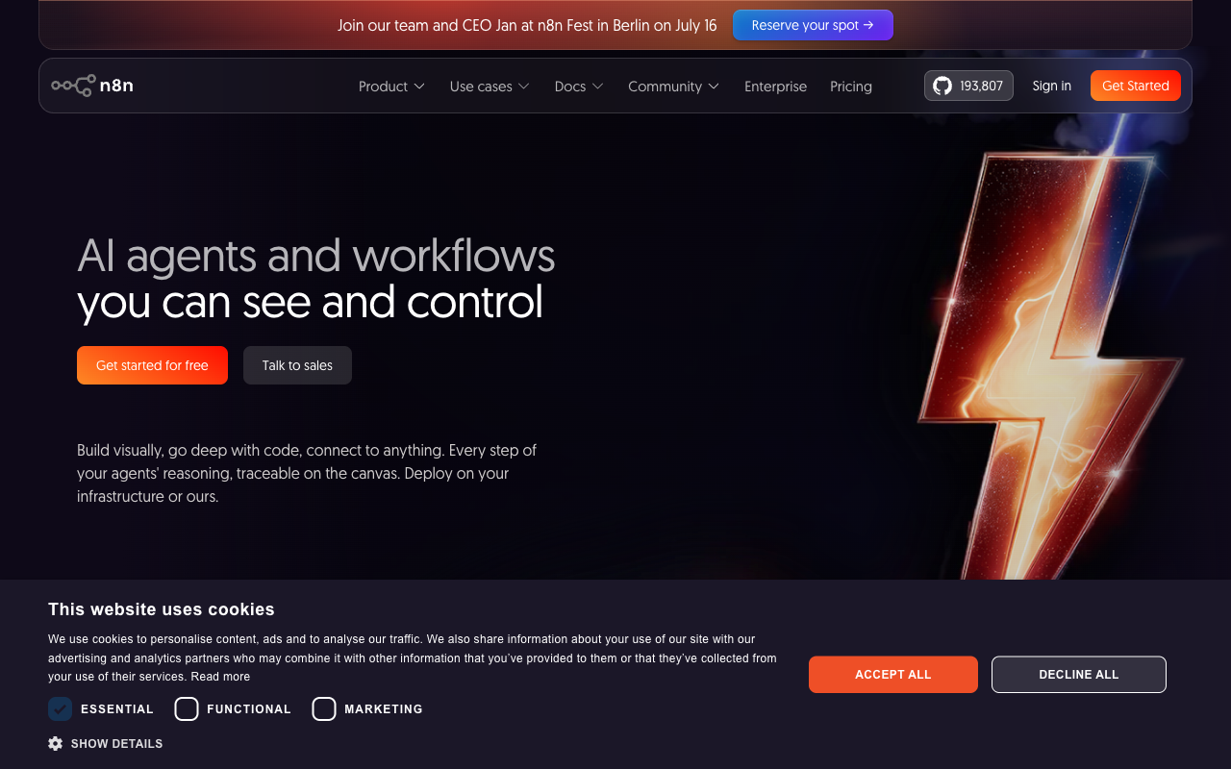
TOPIC 1 · WHAT IS n8n
n8n.io
• n8n is an open, fair-code workflow automation platform.
• Free cloud trial at n8n.io, or self-host with Docker.
• Same visual editor in both.
• This course: start on the cloud trial, keep the Docker option for after.
Agentic AI Automation with n8n · TGS-2023035977
© 2026 Tertiary Infotech Academy Pte Ltd
28

Slide 30
TOPIC 1 · WORKFLOW AUTOMATION
What Automation Removes
Automation is not 'the same work faster' — it removes the hand-offs where a person re-types what another system already knows.
MANUAL
Form filled in
Someone reads it
Re-typed into Excel
Someone remembers to reply
▶
▶
▶
AUTOMATED
Form submitted
Flow triggered
Row written
Reply sent
▶
▶
▶
Consistency
Traceability
Capacity
The same input produces the same output, every time, at 3am.
Every run leaves an execution history someone can read a year later.
People move up to judgement calls; the machine does the re-typing.
Automate the hand-offs first — that is where time and errors live.
Agentic AI Automation with n8n · TGS-2023035977
© 2026 Tertiary Infotech Academy Pte Ltd
29

Slide 31
TOPIC 1 · WORKFLOW AUTOMATION
Every Workflow Is the Same Shape
Trigger first, then actions in order, with data flowing left to right. Only the nodes change.
TRIGGER
what starts it
ACTION
do the work
ACTION
do more work
OUTPUT
reply, store or notify
▶
▶
▶
1
One trigger
2
Actions are ordered
3
Data flows as JSON
A workflow has exactly one entry point. Change the trigger and you have a different flow — the actions may not change at all.
Each action runs after the one before it and can read the outputs of every node before it.
Every node passes a list of JSON items to the next — the same structure in every lab.
Trigger, actions, output. Learn this once in Activity 1 and every later lab is a variation.
Agentic AI Automation with n8n · TGS-2023035977
© 2026 Tertiary Infotech Academy Pte Ltd
30

Slide 32
TOPIC 1 · TRAINING ACCOUNTS
n8n Training Accounts
Each learner signs in to n8n with ONE assigned account. Use only the account your trainer gives you.
#
Account (email)
#
Account (email)
1
n8n18oct1@tertiaryinfotech.com
7
n8n18oct7@tertiaryinfotech.com
2
n8n18oct2@tertiaryinfotech.com
8
n8n18oct8@tertiaryinfotech.com
3
n8n18oct3@tertiaryinfotech.com
9
n8n18oct9@tertiaryinfotech.com
4
n8n18oct4@tertiaryinfotech.com
10
n8n18oct10@tertiaryinfotech.com
5
n8n18oct5@tertiaryinfotech.com
11
n8n18oct11@tertiaryinfotech.com
6
n8n18oct6@tertiaryinfotech.com
12
n8n18oct12@tertiaryinfotech.com
Password: provided by your trainer in class · Do not change the password or save real credentials in it.
Agentic AI Automation with n8n · TGS-2023035977
© 2026 Tertiary Infotech Academy Pte Ltd
31

Slide 33
TOPIC 1 · SIGN IN
Sign In to n8n
1
2
3
4
5
▶
▶
▶
▶
Go to app.n8n.cloud/login — or open your own instance URL directly
Enter your assigned account email, e.g. n8n18oct5@tertiaryinfotech.com
Enter the password your trainer gives you
Open your instance from the dashboard — a free 14-day trial, active through the training
You land in n8n — open Assistant or Overview to start building
Your account is already set up — the name is your email prefix and onboarding is done. Do not change the password.
Agentic AI Automation with n8n · TGS-2023035977
© 2026 Tertiary Infotech Academy Pte Ltd
32

Slide 34
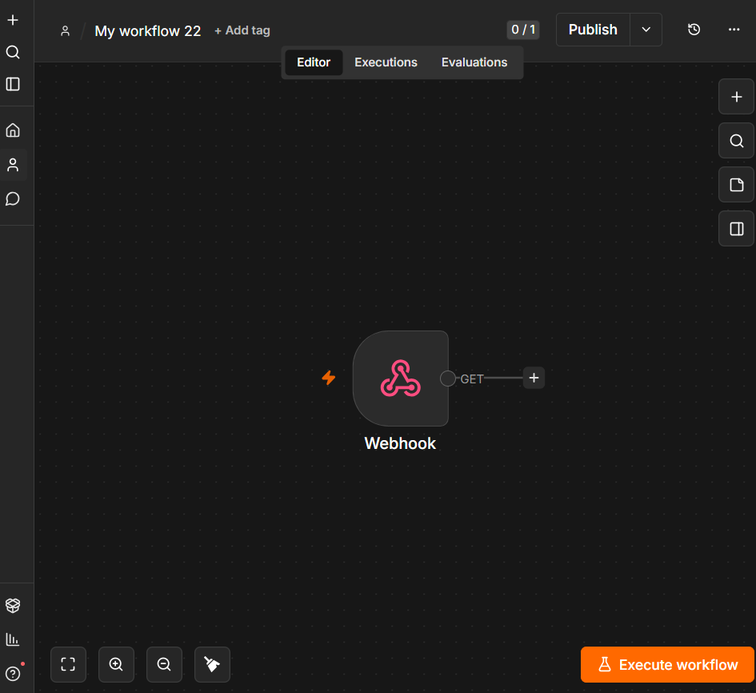
TOPIC 1 · WORKFLOW AUTOMATION
The n8n Editor
n8n canvas: left sidebar navigation · centre canvas · node toolbar · Editor / Executions / Evaluations tabs
Agentic AI Automation with n8n · TGS-2023035977
© 2026 Tertiary Infotech Academy Pte Ltd
33

Slide 35
TOPIC 1 · FREE AI CREDITS
Claim Your Free AI Credits
1
2
3
4
5
▶
▶
▶
▶
Sign in to n8n Cloud with your training account — the free trial includes Gateway credits
Open a workflow and add an AI node, e.g. AI Agent → Gemini or OpenAI Chat Model
In the node's Credential field, choose Use Gateway credits — your balance shows beside it
Pick a supported model and run the node — no provider account or API key needed
Track the balance on the node, or in Admin Panel → Gateway credits
A red "Free AI credits — Enable to claim credits" toast is the legacy OpenAI offer: Gateway instances don't get it. Use Gateway credits.
Agentic AI Automation with n8n · TGS-2023035977
© 2026 Tertiary Infotech Academy Pte Ltd
34

Slide 36
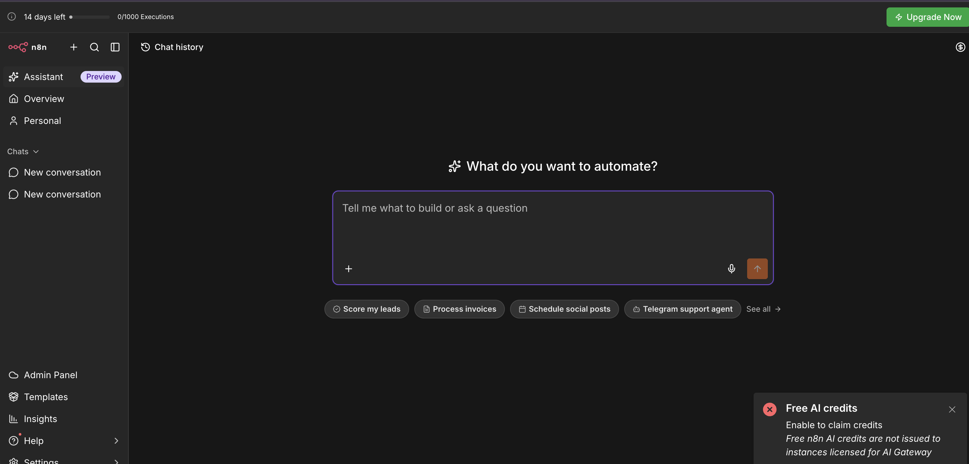
TOPIC 1 · AI-ASSISTED WORKFLOW CREATION
n8n Assistant — Describe It, n8n Builds It
Open Assistant in the sidebar and answer "What do you want to automate?" — it builds a normal workflow you can edit and publish.
Agentic AI Automation with n8n · TGS-2023035977
© 2026 Tertiary Infotech Academy Pte Ltd
35

Slide 37
TOPIC 1 · DEMO
Demo: n8n Assistant Builds a Social Media Campaign
Give n8n Assistant one clear prompt — it plans and builds the workflow below, with a human approval gate.
Form Trigger
you enter a topic
Research
AI Agent + web search
Draft post
AI writes the copy
Human in the loop
email approve / reject
Schedule post
wait, then publish
▶
▶
▶
▶
THE PROMPT
THEN YOU
Create a workflow for a social media marketing campaign:
1. Start from a form where I enter a campaign topic.
2. Research the topic on the web and summarise 3 key points.
3. Draft a LinkedIn post under 150 words from the research.
4. Email me the draft and wait for my approval before posting.
5. If approved, schedule the post for 9am the next weekday;
if rejected, log my feedback in a Google Sheet.
Use Gateway credits for the AI model. Ask me before publishing.
• Review the plan before it builds
• Connect Gmail and the social account when it asks
• Test with a real topic and approve the draft
• Publish only when the run looks right
The AI built it; the workflow runs it — and nothing is posted until a person approves the draft.
Agentic AI Automation with n8n · TGS-2023035977
© 2026 Tertiary Infotech Academy Pte Ltd
36

Slide 38
TOPIC 1 · WORKFLOW AUTOMATION
Trigger Nodes — What Is Allowed to Start a Workflow
The trigger you choose is a statement about who or what may start the process.
1
Manual Trigger
2
Schedule Trigger
3
Form Trigger
Click Execute Workflow — for building and testing, and for one-off jobs like the Activity 7b ingestion run.
A clock starts the flow — cron or interval. Reports, reminders, nightly syncs.
n8n hosts a web form for you; each submission starts a run. Activities 1–3.
4
Webhook
5
Chat / Telegram Trigger
6
App & Email Triggers
External systems call a URL you expose. Websites and apps — Activities 5, 7b, 8.
Each chat message starts a run — n8n's chat UI or your Telegram bot. Activities 4, 6, 7a.
On new Gmail, new Sheet row, new Drive file, new IMAP email — react to changes in apps you already use.
Pick the trigger by asking: who or what should be allowed to start this process?
Agentic AI Automation with n8n · TGS-2023035977
© 2026 Tertiary Infotech Academy Pte Ltd
37

Slide 39
TOPIC 1 · WORKFLOW AUTOMATION
Triggers Used in This Course
Every lab's trigger, and why that trigger is the right front door.
Trigger
Where
Why it fits
Form Trigger
Activities 1, 2, 3a, 3b
A visitor RSVP must start the flow
Telegram Trigger
Activities 4a, 4b, 6, 7a
Each bot message is one conversation turn
Webhook — POST
Activities 5, 7b, 8a, 8c
A website sends data and waits for a reply
Webhook — GET
Activity 8b
The dashboard pulls JSON from a URL
Manual Trigger
Activity 7b ingestion
A human runs the document load once
Schedule and app triggers follow the same pattern — swap the front door, keep the flow.
Agentic AI Automation with n8n · TGS-2023035977
© 2026 Tertiary Infotech Academy Pte Ltd
38

Slide 40
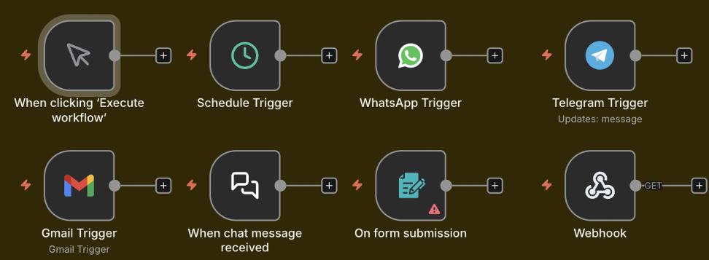
TOPIC 1 · WORKFLOW AUTOMATION
Trigger Nodes on the n8n Canvas
n8n trigger nodes: Manual · Schedule · WhatsApp · Telegram · Gmail · Chat · Form · Webhook
Agentic AI Automation with n8n · TGS-2023035977
© 2026 Tertiary Infotech Academy Pte Ltd
39

Slide 41
TOPIC 1 · WORKFLOW AUTOMATION
Data-Processing Nodes — The Workhorses
Between the trigger and the output, these nodes shape, route and transform the data.
1
Edit Fields (Set)
2
IF / Switch
3
Filter
4
Merge
Add, rename or reshape fields — the node you reach for first when data is the wrong shape.
Branch the flow: IF gives true/false paths; Switch gives one path per case.
Let only matching items continue — drop the rest of the list.
Combine two branches — append rows, match by key, or choose one side.
5
Split Out / Aggregate
6
Code
7
Loop / Wait
8
HTTP Request
Turn one item holding a list into many items — and back again.
JavaScript or Python for the 5% a built-in node cannot do.
Process items in batches; pause a flow for time or an event.
Call any API on the internet — the universal escape hatch.
Most flows are: trigger → reshape (Set) → decide (IF) → act (app node). Reach for Code last.
Agentic AI Automation with n8n · TGS-2023035977
© 2026 Tertiary Infotech Academy Pte Ltd
40

Slide 42

TOPIC 1 · WORKFLOW AUTOMATION
Data-Processing Nodes on the Canvas
If · Switch · Filter · Edit Fields · Split Out · Aggregate · Merge · Loop · Date & Time · Execute Workflow · Wait · Code
Agentic AI Automation with n8n · TGS-2023035977
© 2026 Tertiary Infotech Academy Pte Ltd
41

Slide 43
TOPIC 1 · WORKFLOW AUTOMATION
Where the Data Goes — Storage & App Actions
Action nodes that write the result somewhere useful.
1
Data Table
2
Google Sheets / Excel
n8n's built-in spreadsheet — instant, no credential. Trial Data Tables are NOT permanent; use for class demos.
A real spreadsheet you keep — OAuth2 credential, Append Row. The persistent upgrade in Activity 3b.
3
Gmail / Outlook
4
Vector Store
Send (and in Activity 8a, Send and Wait for Response) — email as an output and as an approval gate.
Store embeddings for RAG — in-memory for demos, Pinecone / Supabase / Qdrant for production.
Anything you must keep goes to external storage — trial Data Tables vanish with the trial.
Agentic AI Automation with n8n · TGS-2023035977
© 2026 Tertiary Infotech Academy Pte Ltd
42

Slide 44
TOPIC 1 · WORKFLOW AUTOMATION
JSON — How Data Travels Between Nodes
Every node passes a list of items; each item is a JSON object of key/value pairs.
• JSON (JavaScript Object Notation) is a simple text format for data.
• Values can be text, numbers, true/false, lists [ ] or nested objects { }.
• Most APIs send and receive JSON — so does every n8n node.
• Click any node to inspect its input and output JSON.
ONE FORM SUBMISSION AS JSON
{
"Name": "Alice Tan",
"Email": "alice@corp.com",
"Attending": "Yes",
"Pax": 2
}
Read any value later with an expression: {{ $json.Name }} → "Alice Tan"
Agentic AI Automation with n8n · TGS-2023035977
© 2026 Tertiary Infotech Academy Pte Ltd
43

Slide 45
TOPIC 1 · WORKFLOW AUTOMATION
Expressions — The Token, Not the Text
An expression references a value that will exist at run time — it is resolved fresh on every run.
Trigger runs
a submission arrives
Outputs exist
Name, Email, Attending…
Later node references them
{{ $json.Name }}
Value arrives at run time
different every run
▶
▶
▶
✓ Mapped with the picker
✗ Typed as plain text
Drag the field from the input panel — n8n writes the expression for you and shows a live preview of the resolved value.
Type 'Name' as literal text and every email says 'Name'. If the path is wrong the value resolves to empty — not to an error.
Use expressions in any field — subject lines, URLs, conditions. Drag, don't type.
Agentic AI Automation with n8n · TGS-2023035977
© 2026 Tertiary Infotech Academy Pte Ltd
44

Slide 46
TOPIC 1 · WORKFLOW AUTOMATION
Test vs Production Executions
The same workflow runs in two modes — know which one you are looking at.
TEST — in the editor
PRODUCTION — Active toggle ON
• Click Execute Workflow to run once.
• Data is shown live on the canvas, node by node.
• Pin a node's output to freeze it while you build downstream.
• Perfect for building — nothing needs to be Active.
• Runs automatically when the trigger fires.
• Nothing appears on the canvas — runs are logged in Executions.
• Every run records status, timing and full data per node.
• This is what your users experience.
The Executions list is the honest account of what happened — debug from there, not from memory.
Agentic AI Automation with n8n · TGS-2023035977
© 2026 Tertiary Infotech Academy Pte Ltd
45

Slide 47

TOPIC 1 · WORKFLOW AUTOMATION
Execution History
Executions tab — each run shows status, duration, ID and the full data at every node
Agentic AI Automation with n8n · TGS-2023035977
© 2026 Tertiary Infotech Academy Pte Ltd
46

Slide 48
TOPIC 1 · WORKFLOW AUTOMATION
Credentials — Connect Your Accounts Once
Nodes reference credentials by name; set them up once under Credentials → Add credential.
1
Email
2
LLM
Gmail or Outlook via OAuth2 — used from Activity 1 onward.
Free n8n Gateway credits (no key needed), or your own OpenAI / Google Gemini API key — powers every AI agent from Activity 4.
3
Telegram
4
Google Sheets
Bot token from @BotFather — the chat front door for Activities 4, 6, 7a.
OAuth2 to your Google account — persistent storage in Activity 3b.
Imported workflows keep credential NAMES only — always re-select your own after importing.
Agentic AI Automation with n8n · TGS-2023035977
© 2026 Tertiary Infotech Academy Pte Ltd
47

Slide 49

TOPIC 1 · LAB WORKFLOW
Activity 1 — Flyer with QR Code (Form → Email)
Collect a visitor's RSVP with a hosted n8n Form and email it to the admin — then put the form's QR code on a real event flyer.
Form Trigger
visitor submits the RSVP
Gmail — Send
admin receives the details
▶
ACT 1
Flyer with QR Code (Form → Email)
Form Trigger → Gmail · Gmail OAuth2 credential · full steps in the Learner Guide
Agentic AI Automation with n8n · TGS-2023035977
© 2026 Tertiary Infotech Academy Pte Ltd
48

Slide 50
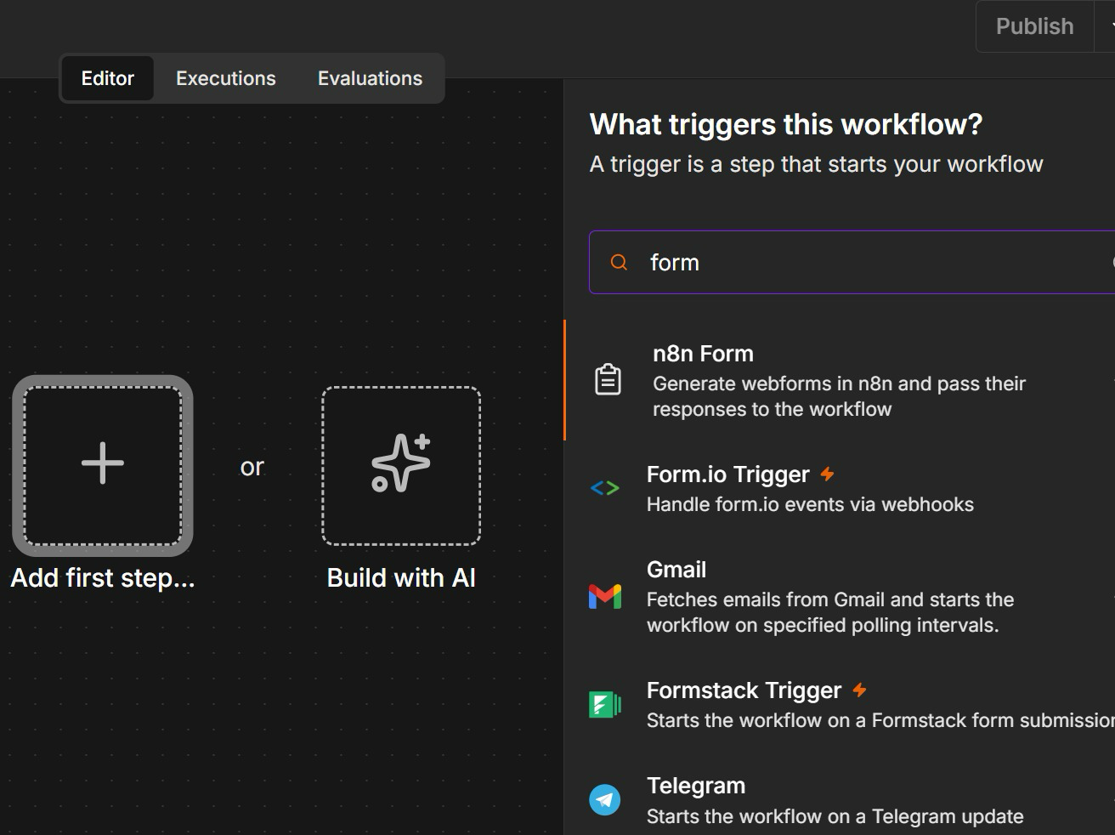
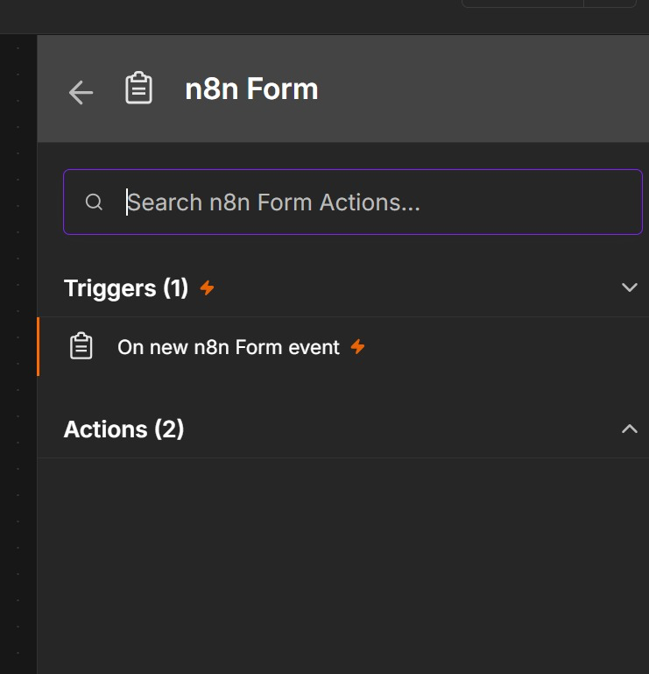
ACT 1 · IN n8n
Activity 1 — Add the n8n Form Trigger
Click Add first step (+), search 'form' and choose n8n Form → On new n8n Form event. Then add the Name, Email, Phone and Message fields.
Agentic AI Automation with n8n · TGS-2023035977
© 2026 Tertiary Infotech Academy Pte Ltd
49

Slide 51
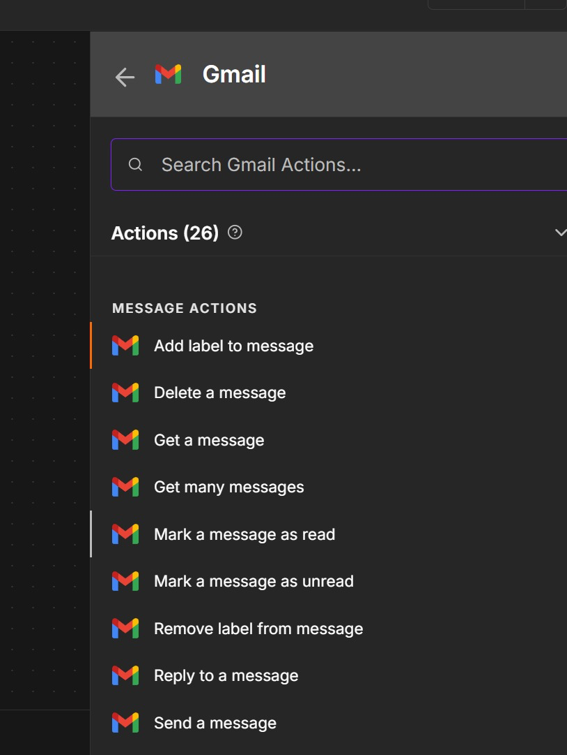
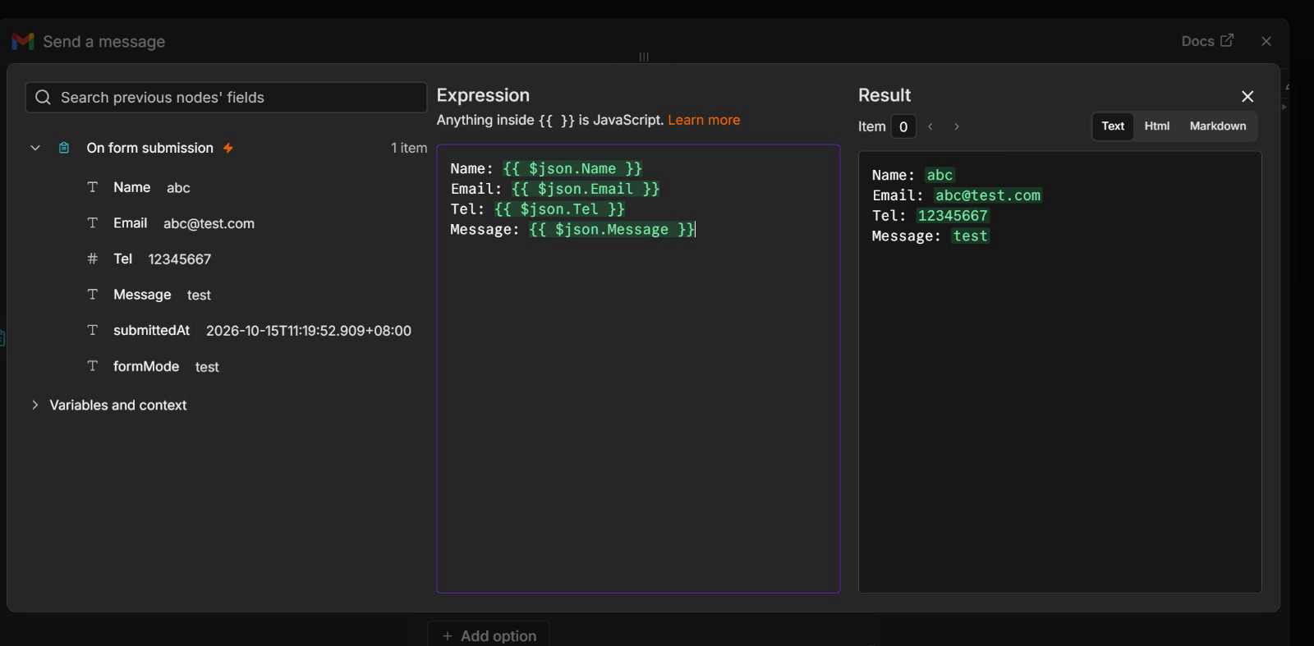
ACT 1 · IN n8n
Activity 1 — Gmail: Send a Message with Expressions
Add Gmail → Send a message. Switch Message to Expression and drag in the form fields — the Result panel previews the email before you run it.
Agentic AI Automation with n8n · TGS-2023035977
© 2026 Tertiary Infotech Academy Pte Ltd
50

Slide 52




ACT 1 · GROUP ACTIVITY
Sample Flyers from Past Students
Each QR code encodes the form's Production URL — scan it, register, and the event administrator receives the details by email.
Agentic AI Automation with n8n · TGS-2023035977
© 2026 Tertiary Infotech Academy Pte Ltd
51

Slide 53
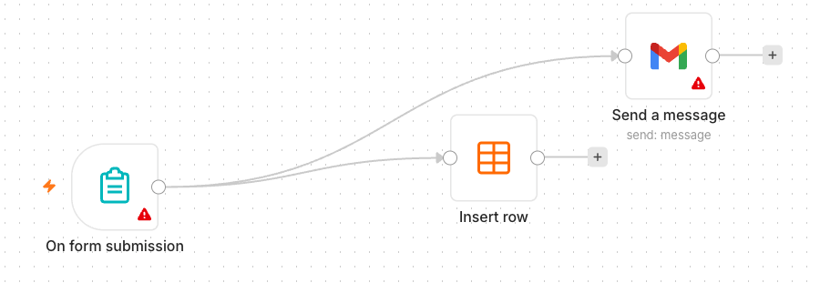
TOPIC 1 · LAB WORKFLOW
Activity 2 — Capture Submissions in a Data Table
Extend Activity 1 so every submission is also saved — your first taste of storing data, not just forwarding it.
Form Trigger
same RSVP form
Data Table — Insert Row
every submission saved
Gmail — Send
admin still notified
▶
▶
ACT 2
Capture Submissions in a Data Table
Form Trigger → Data Table + Gmail · columns mapped with {{ $json.… }} expressions · steps in the Learner Guide
Agentic AI Automation with n8n · TGS-2023035977
© 2026 Tertiary Infotech Academy Pte Ltd
52

Slide 54
Lunch Break
1 hour · see you at 2:00 pm
Agentic AI Automation with n8n · TGS-2023035977
© 2026 Tertiary Infotech Academy Pte Ltd
53

Slide 55
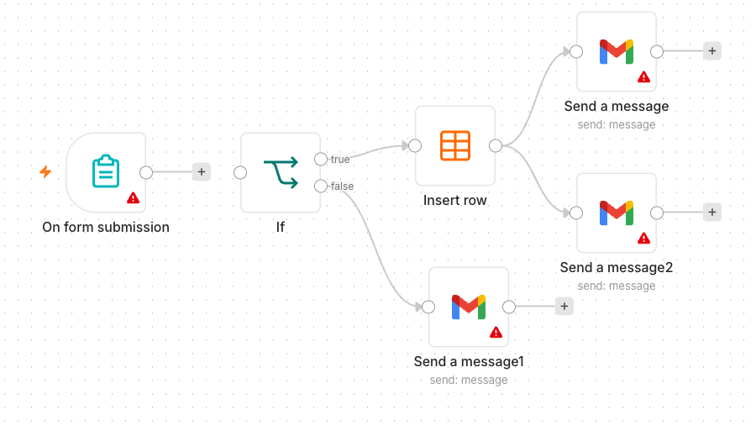
TOPIC 1 · LAB WORKFLOW
Activity 3a — Conditional Response (Data Table)
Add decision-making: attending guests are saved; everyone else gets a polite thank-you email.
Form Trigger
+ Attending? Yes/No field
IF
Attending = Yes ?
Data Table
YES → save the RSVP
Gmail
NO → thank-you email
▶
▶
▶
ACT 3a
Conditional Response (Data Table)
Form → IF → Data Table / Gmail · both branches must be built · steps in the Learner Guide
Agentic AI Automation with n8n · TGS-2023035977
© 2026 Tertiary Infotech Academy Pte Ltd
54

Slide 56
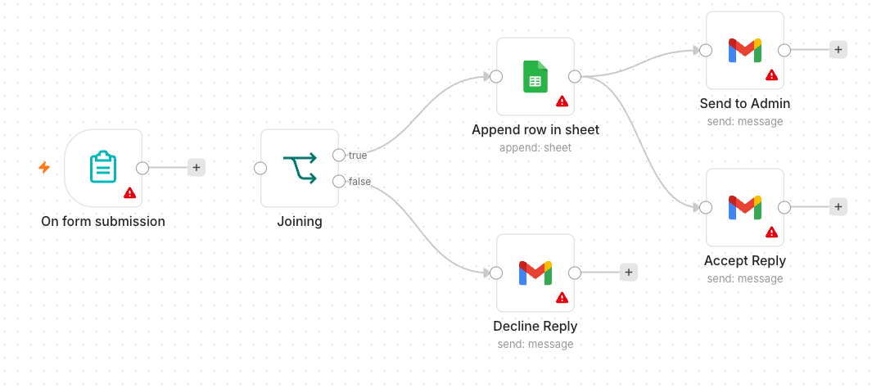
TOPIC 1 · LAB WORKFLOW
Activity 3b — Conditional Response (Google Sheets)
Same logic, persistent storage: the YES branch appends to a real Google Sheet you keep after the trial.
Form Trigger
same form
IF
Attending = Yes ?
Google Sheets — Append
YES → a spreadsheet you keep
Gmail
NO → thank-you email
▶
▶
▶
ACT 3b
Conditional Response (Google Sheets)
Form → IF → Google Sheets / Gmail · Google Sheets OAuth2 · steps in the Learner Guide
Agentic AI Automation with n8n · TGS-2023035977
© 2026 Tertiary Infotech Academy Pte Ltd
55

Slide 57
02
TOPIC 2
AI Agents
Components of an agent · model, memory, tools, instructions · model parameters · MCP
Applied in Activities 4a and 4b
Agentic AI Automation with n8n · TGS-2023035977
© 2026 Tertiary Infotech Academy Pte Ltd
56

Slide 58
TOPIC 2 · AI AGENTS
Components of an AI Agent
Four parts, one hub: the agent node wires them together — and only some are under your direct control.
MODEL
MEMORY
The LLM 'brain' — interprets language, reasons, chooses the next step. gpt-4.1-mini in this course.
Keeps the conversation — follow-up questions still make sense. Window buffer per chat/session.
THE AI AGENT
plans · decides · calls tools
TOOLS
INSTRUCTIONS
Abilities it may use: Data Table lookups, vector stores, HTTP calls, sub-workflows.
The system message — identity, scope, rules and refusals. Always in force.
Model + Memory + Tools + Instructions — every agent in this course is exactly these four parts.
Agentic AI Automation with n8n · TGS-2023035977
© 2026 Tertiary Infotech Academy Pte Ltd
57

Slide 59
TOPIC 2 · AI AGENTS
The Model — Popular LLM Providers
Any chat model plugs into the same AI Agent node — swap the brain, keep the agent.
Provider
Models
Notes
OpenAI
gpt-4.1, gpt-4.1-mini, gpt-4o
Course default: gpt-4.1-mini
Google
Gemini 2.x Flash / Pro
Used for embeddings in Activity 7
Anthropic
Claude (Opus, Sonnet, Haiku)
Strong reasoning and safety
Meta
Llama 3.x
Open weights — self-hostable
Mistral
Mistral / Mixtral
Open weights — EU option
Pick by task: small fast models for classification and guardrails, larger models for reasoning.
Agentic AI Automation with n8n · TGS-2023035977
© 2026 Tertiary Infotech Academy Pte Ltd
58

Slide 60
TOPIC 2 · AI AGENTS
Model Parameters — Temperature and Friends
Settings on the chat-model node shape how the model answers — the most important is temperature.
1
Temperature 0 – 0.3
2
Temperature ≈ 0.7
3
Temperature 1.0 +
Deterministic and repeatable. Use for classification, guardrails, data extraction — automation that must give the same decision twice.
Balanced — natural-sounding chat with some variety. The default for customer-facing assistants.
Creative and surprising. Marketing copy and brainstorming — never for decisions.
1
Top-p
2
Max tokens
3
Frequency / presence penalty
Alternative sampling control — limits choices to the most probable tokens. Tune temperature OR top-p, not both.
Caps the length of the reply — protects cost and keeps chat answers short.
Discourage repetition and nudge new topics — useful for long generations.
For business automation keep temperature LOW — the same input should produce the same decision.
Agentic AI Automation with n8n · TGS-2023035977
© 2026 Tertiary Infotech Academy Pte Ltd
59

Slide 61
TOPIC 2 · AI AGENTS
Memory — Why the Agent Remembers
Without memory every message is a stranger; with it, 'what about tomorrow?' makes sense.
Msg 1: 'Any leave left?'
agent answers: 12 days
Stored in memory
keyed by chat / session ID
Msg 2: 'What about Bob?'
agent knows the topic is leave
Window slides
only the last N turns kept
▶
▶
▶
Simple (buffer window) memory
Session key
Keeps the last N exchanges of THIS conversation — n8n's default, used in all course agents.
Memory is per chat ID — two Telegram users never see each other's context.
Memory is conversation context — it is NOT long-term knowledge. Facts live in tools and documents (RAG).
Agentic AI Automation with n8n · TGS-2023035977
© 2026 Tertiary Infotech Academy Pte Ltd
60

Slide 62
TOPIC 2 · AI AGENTS
Tools — What the Agent May Do
Attach tools to the agent's Tool input; the model decides when to call one, based on your description.
1
Data Table / Sheets tool
2
Vector Store tool
Look up structured records — the Employees table in Activity 4b.
Retrieve document chunks for grounded answers — the knowledge_base in Activity 7.
3
HTTP Request tool
4
Sub-workflow tool
Call any external API mid-conversation — prices, weather, CRM.
Wrap an entire n8n workflow as one callable tool — your own logic, on demand.
The tool DESCRIPTION is how the agent knows when to call it — write it for the model, not for a developer.
Agentic AI Automation with n8n · TGS-2023035977
© 2026 Tertiary Infotech Academy Pte Ltd
61

Slide 63
TOPIC 2 · AI AGENTS
Instructions — The Four Parts That Constrain
The system message is always in force. Every good agent instruction in this course states four things.
1
Identity
2
Source rules
Who the agent is and what it must never do. 'You are HR Buddy, the HR assistant for staff of Acme Pte Ltd.'
Where answers come from. 'Answer ONLY from the Employees tool / the uploaded documents.'
3
Refusals
4
Escalation
What is out of bounds, stated positively. 'Do not reveal salaries or another person's records.'
What to do at the boundary. 'If unsure, say so and direct the user to hr@acme.com.'
Vague instructions produce confident wrong answers — every rule you skip, the model improvises.
Agentic AI Automation with n8n · TGS-2023035977
© 2026 Tertiary Infotech Academy Pte Ltd
62

Slide 64
TOPIC 2 · AI AGENTS
Good vs Bad Instructions
The same bot, two system messages — one is testable, one is a hope.
✗ TOO VAGUE
✓ CONSTRAINED
"You are a helpful assistant. Answer the user's questions politely."
"You are HR Buddy, the HR assistant for Acme staff.
Answer only questions on leave policy, payroll dates and claims.
Use the Employees tool for any staff lookup — never answer from general knowledge.
Never reveal salaries or another employee's personal data.
If you are not sure, say so and direct the user to hr@acme.com."
No identity · no sources · no refusals · no escalation.
It will happily invent leave balances and reveal other people's data — politely.
Identity · source rules · refusals · escalation — you can test each line by trying to break it.
Agentic AI Automation with n8n · TGS-2023035977
© 2026 Tertiary Infotech Academy Pte Ltd
63

Slide 65
TOPIC 2 · AI AGENTS
MCP — Model Context Protocol
An open standard that gives agents a common plug for tools and data — instead of one custom integration per pair.
AI Agent
any MCP-capable client
MCP Client
speaks the protocol
MCP Server
exposes tools + data
Your Systems
databases, APIs, files
▶
▶
▶
Without MCP
With MCP
Every agent × every tool needs its own custom integration — N agents and M tools means N × M connectors to build and maintain.
Build ONE MCP server per system; any MCP-capable agent can use it. N + M pieces, and tools become reusable across agents.
MCP is like USB-C for AI tools — one connector, many devices.
Agentic AI Automation with n8n · TGS-2023035977
© 2026 Tertiary Infotech Academy Pte Ltd
64

Slide 66
TOPIC 2 · AI AGENTS
MCP in n8n
MCP SERVER TRIGGER — n8n serves tools
MCP CLIENT TOOL — n8n consumes tools
• Expose your n8n workflows AS tools over MCP.
• Claude, IDEs or other agents call your flows directly.
• n8n becomes the tool layer for any MCP client.
• Auth via bearer token on the server URL.
• Attach external MCP servers to your n8n AI Agent.
• The agent gains their tools without custom nodes.
• Mix MCP tools with native n8n tools freely.
• Same agent loop — more reach.
Two directions, one protocol: n8n can serve tools to other agents, and borrow tools for its own.
Agentic AI Automation with n8n · TGS-2023035977
© 2026 Tertiary Infotech Academy Pte Ltd
65

Slide 67
TOPIC 2 · LAB WORKFLOW
Activity 4a — An HR Policy Chatbot on Telegram
What is a chatbot? An agent behind a chat channel. Your first agent, Ava, answers staff questions on company HR policies.
Telegram Trigger
an employee messages the bot
HR Agent — Ava
HR policies + memory
Chat model
Gateway credits, no API key
Reply on Telegram
back to the same chat
▶
▶
▶
1
What Ava knows
2
Guardrails in the prompt
3
Then give her a tool
Sample HR policies written into the system instruction — leave, sick leave, claims, hours, probation.
Answer only from the policies, never invent a number, and refer salary, medical or disciplinary questions to HR.
Activity 4b attaches an Employees Data Table, so Ava can also answer from real staff records.
You will: create a bot with BotFather → build the workflow with n8n Assistant → connect, publish and chat.
Agentic AI Automation with n8n · TGS-2023035977
© 2026 Tertiary Infotech Academy Pte Ltd
66

Slide 68
TOPIC 2 · ACTIVITY 4a
Step 1: Create a Telegram Bot with BotFather
1
2
3
4
5
▶
▶
▶
▶
Open Telegram and search for BotFather (blue checkmark)
Start a chat and send /newbot
Type a display name, e.g. My Free Helper Bot
Choose a unique username ending in bot, e.g. my_free_helper_bot
Copy the HTTP API token BotFather sends back
The token is the bot's password — never share or commit it. If it leaks, send /revoke to BotFather for a new one.
Agentic AI Automation with n8n · TGS-2023035977
© 2026 Tertiary Infotech Academy Pte Ltd
67

Slide 69
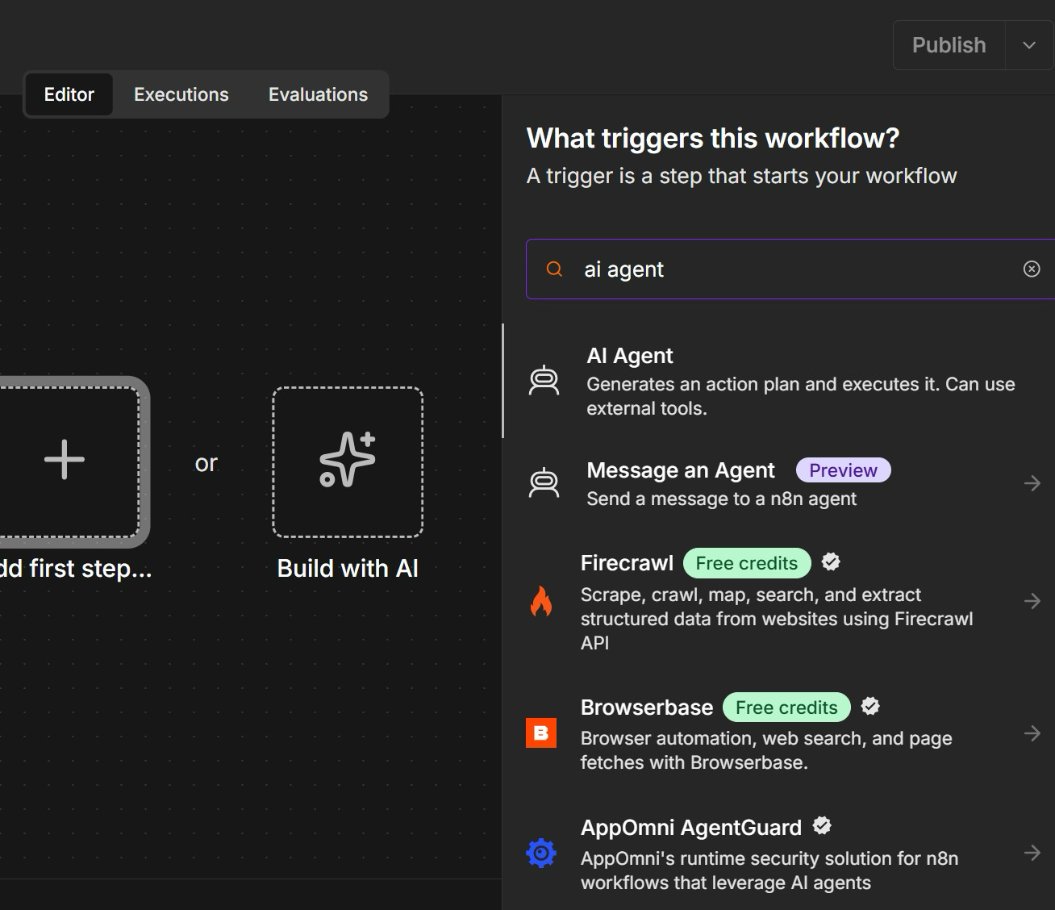
TOPIC 2 · ACTIVITY 4a
Step 2a: Open n8n Assistant with Build with AI
• Create a new workflow. The empty canvas offers two starts: Add first step, or Build with AI.
• Click Build with AI — this opens n8n Assistant, which builds the workflow from a plain-English prompt.
• Add first step is the manual route: it opens the node search, here filtered to 'ai agent'.
• Either way you get the same nodes. The Assistant just writes the first draft for you.
Build with AI drafts the workflow; you still review every node before you publish.
Agentic AI Automation with n8n · TGS-2023035977
© 2026 Tertiary Infotech Academy Pte Ltd
68

Slide 70
TOPIC 2 · ACTIVITY 4a
Step 2b: Paste the Prompt into n8n Assistant
Create a new workflow, open n8n Assistant and paste this prompt — it plans and builds the chatbot for you.
THE PROMPT
THEN YOU
Create a 3-node workflow:
• A user posts a message to a Telegram bot.
• Telegram sends the data to an HR agent.
• The HR agent responds to the user on the company HR policies. Create a system instruction for the HR agent with sample company policies in it. The HR agent has a memory.
• Respond to Telegram.
• Review the plan before it builds
• Read the system instruction it wrote — edit the sample policies if you like
• Check a memory node is attached to the HR agent
• Stuck? Import the reference solution instead
Reference solution: labs/activity4-telegram-agent/Activity4a-Telegram-HR-Agent.json
Agentic AI Automation with n8n · TGS-2023035977
© 2026 Tertiary Infotech Academy Pte Ltd
69

Slide 71
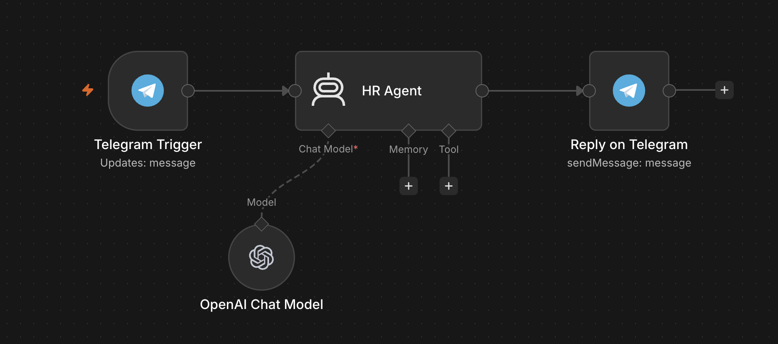
TOPIC 2 · ACTIVITY 4a
The Workflow n8n Assistant Builds
Your canvas should look like this: trigger, agent, reply — with the chat model and memory hanging under the agent.
1
Telegram Trigger
2
HR Agent
3
Model and memory
4
Reply out
Updates: message — every message sent to the bot starts one execution.
Ava's role, rules and sample HR policies live in the system instruction n8n Assistant wrote.
Chat model on Gateway credits; memory keeps each employee's conversation, keyed on the chat ID.
Reply on Telegram sends back to the chat ID the trigger received, so the reply lands in the same chat.
Shown before memory was added — check yours has a memory node (the reference file has one).
Agentic AI Automation with n8n · TGS-2023035977
© 2026 Tertiary Infotech Academy Pte Ltd
70

Slide 72
TOPIC 2 · ACTIVITY 4a
Step 3: Connect the Bot, Publish and Chat
1
2
3
4
5
▶
▶
▶
▶
Telegram Trigger → Credential → Create new → paste the token
Telegram reply node → select the same credential
Chat model → Use Gateway credits
Publish — n8n registers its webhook with Telegram
Open t.me/<username>, tap Start, ask about annual leave
A Telegram bot has ONE webhook at a time — testing in the editor swaps in the Test URL, so publish again when you are done.
Agentic AI Automation with n8n · TGS-2023035977
© 2026 Tertiary Infotech Academy Pte Ltd
71

Slide 73
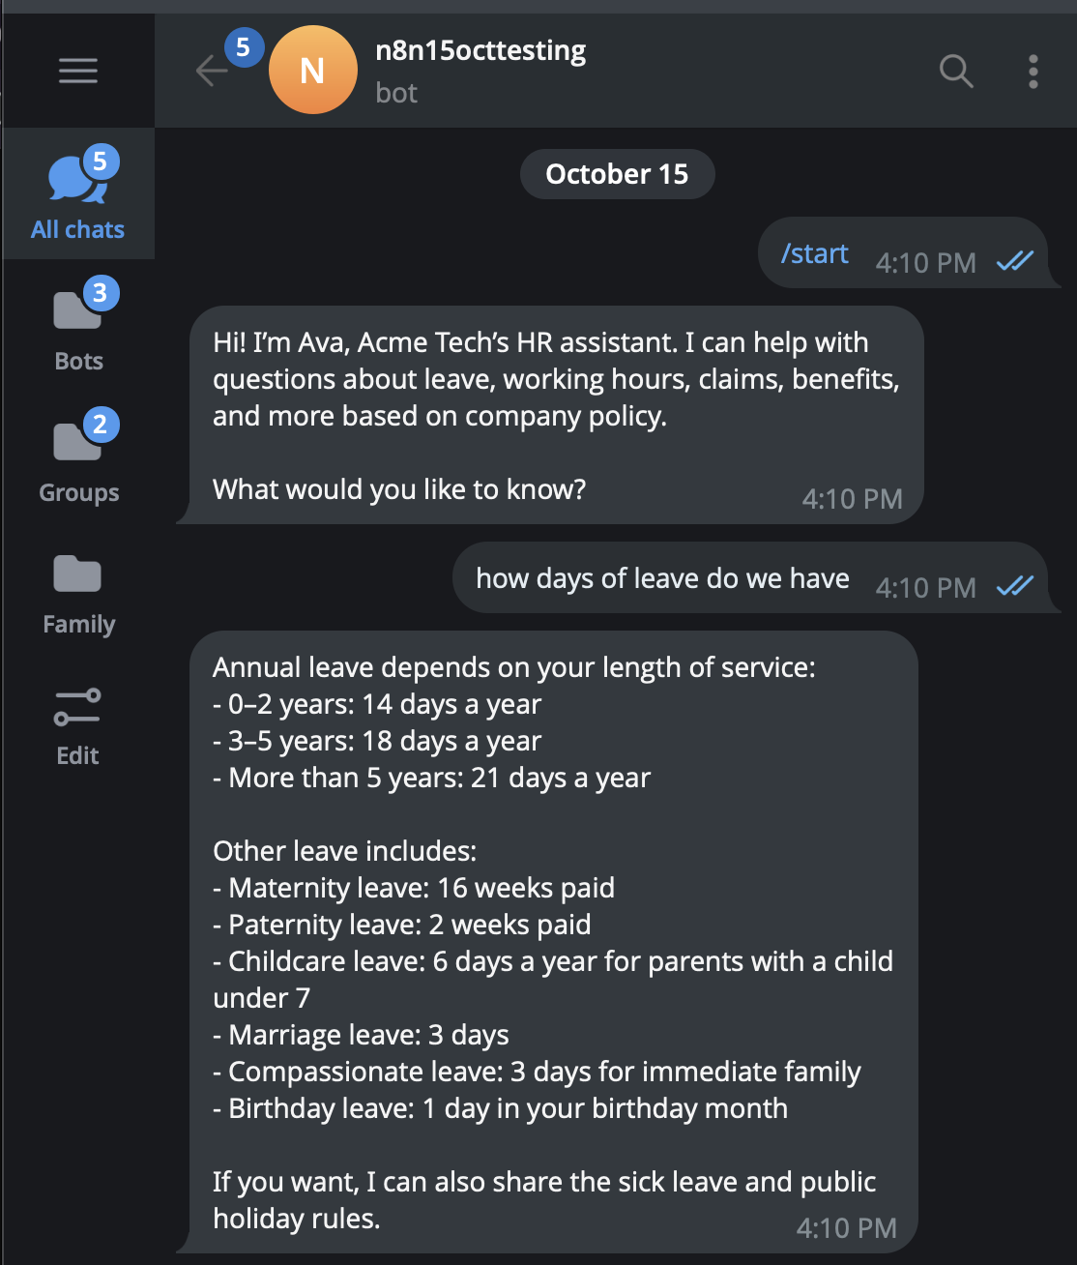
TOPIC 2 · ACTIVITY 4a
Chatting with Ava on Telegram
• /start opens the chat — Ava introduces herself exactly as her system message tells her to.
• Ask how many days of leave you get: the answer quotes the policy — 14, 18 or 21 days by length of service.
• Ask a follow-up — memory keeps the context. Then ask about a colleague's salary: Ava must refer you to HR.
• Every message is one workflow run — open Executions in n8n to watch it happen.
The bot is only as safe as its system message. Activity 4b gives Ava a tool: the Employees Data Table.
Agentic AI Automation with n8n · TGS-2023035977
© 2026 Tertiary Infotech Academy Pte Ltd
72

Slide 74
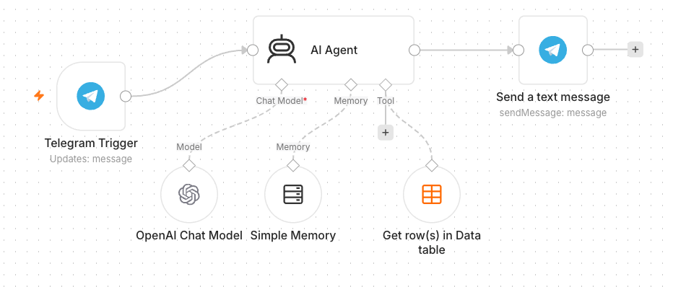
TOPIC 2 · LAB WORKFLOW
Activity 4b — Agent + Data Table Tool (HR Admin)
Give Ava a tool: an Employees Data Table (100 records) she can query — answers now come from real staff records.
Telegram Trigger
same bot
AI Agent
+ Employees Data Table tool
Telegram — Send
answers grounded in the table
▶
▶
Reference layout — in your build the agent is Ava (HR Agent) and the reply node is Reply on Telegram.
ACT 4b
Agent + Data Table Tool (HR Admin)
Tool description tells the agent WHEN to use it · instruction updated to route staff questions · steps in the Learner Guide
Agentic AI Automation with n8n · TGS-2023035977
© 2026 Tertiary Infotech Academy Pte Ltd
73

Slide 75
WRAP-UP
End of Day 1 — Recap
• You built form automations, conditional logic and storage (Data Table → Google Sheets).
• You met the agent's four parts — model, memory, tools, instructions — and MCP.
• You shipped a Telegram AI agent, then grounded it in an Employees table.
• Tomorrow: webhooks, external APIs, and RAG.
Agentic AI Automation with n8n · TGS-2023035977
© 2026 Tertiary Infotech Academy Pte Ltd
74

Slide 76
03
TOPIC 3
Webhooks
The inbound URL · GET vs POST · Test vs Production URL · responding to the caller
Applied in Activity 5
Agentic AI Automation with n8n · TGS-2023035977
© 2026 Tertiary Infotech Academy Pte Ltd
75

Slide 77
TOPIC 3 · WEBHOOKS
What Is a Webhook?
A URL your workflow listens on. When the outside world calls it, your workflow runs — the reverse of you calling an API.
Event happens
visitor sends a chat message
HTTP request to your URL
the website POSTs JSON
Workflow runs
n8n receives the data as input
Respond to Webhook
your reply returns to the caller
▶
▶
▶
1
Push, not pull
2
Any caller
3
Paired node
No polling, no schedule — the caller notifies you the moment something happens.
Websites, payment providers, forms, apps — anything that can send an HTTP request.
Webhook starts the flow; Respond to Webhook sends the answer back on the same connection.
A webhook is the reverse of an API call — the outside world calls YOU when an event happens.
Agentic AI Automation with n8n · TGS-2023035977
© 2026 Tertiary Infotech Academy Pte Ltd
76

Slide 78

TOPIC 3 · WEBHOOKS
Webhook Nodes in n8n
Webhook node starts the workflow when called · Respond to Webhook node returns data to the caller
Agentic AI Automation with n8n · TGS-2023035977
© 2026 Tertiary Infotech Academy Pte Ltd
77

Slide 79
TOPIC 3 · WEBHOOKS
Webhook vs HTTP Request — Direction of the Call
WEBHOOK — inbound
HTTP REQUEST — outbound
• An external service calls YOUR workflow.
• You react the moment an event happens.
• The trigger of the flow.
• Activity 5: the website calls your agent.
• YOUR workflow calls an external service.
• You pull data when you choose.
• An action inside the flow.
• Activity 6: your flow calls Twelve Data.
Same HTTP underneath — the only difference is who dials.
Agentic AI Automation with n8n · TGS-2023035977
© 2026 Tertiary Infotech Academy Pte Ltd
78

Slide 80
TOPIC 3 · WEBHOOKS
HTTP Methods on a Webhook — GET vs POST
The method is part of the contract with the caller: where the data rides, and what the call means.
GET — read
POST — send
• Data rides in the URL query string:
– ?email=alice@corp.com
• A browser can call it by just visiting the URL.
• Read in n8n as {{ $json.query.email }}.
• Activity 8b: the dashboard GETs its leave data.
• Data rides in the request body as JSON:
– { "message": "How much is the course?" }
• Used by website chat, forms and app callbacks.
• Read in n8n as {{ $json.body.message }}.
• Activities 5, 7b, 8a, 8c: the site POSTs to the flow.
GET reads, POST sends. Set the method on the Webhook node — the caller must match it.
Agentic AI Automation with n8n · TGS-2023035977
© 2026 Tertiary Infotech Academy Pte Ltd
79

Slide 81
TOPIC 3 · WEBHOOKS
Test URL vs Production URL
Every Webhook node gives you TWO URLs — they behave differently, and mixing them up is the #1 webhook bug.
TEST URL — /webhook-test/…
PRODUCTION URL — /webhook/…
• Works only while you click 'Listen for test event'.
• Handles ONE call, then stops listening.
• The run appears live on the canvas — great for debugging.
• Dies the moment you leave the editor.
• Requires the workflow toggled Active.
• Always on — every call starts a run.
• Runs are logged in the Executions list, not on the canvas.
• This is the URL you give to websites and apps.
Websites must call the PRODUCTION URL of an ACTIVE workflow — the Test URL stops when you leave the editor.
Agentic AI Automation with n8n · TGS-2023035977
© 2026 Tertiary Infotech Academy Pte Ltd
80

Slide 82
TOPIC 3 · WEBHOOKS
Configuring the Webhook Node
Four settings decide whether the browser's call succeeds.
1
Method + Path
2
Allowed Origins (CORS)
GET or POST, and the path that ends your URL — e.g. POST /webhook/hr-chat.
Browsers block cross-site calls unless allowed — set * in class so a local HTML page can call n8n.
3
Response mode
4
Authentication
Immediately (ack), when the flow finishes, or via a Respond to Webhook node — the course flows use Respond to Webhook.
None for demos; Basic / Header / JWT for anything real — a public URL is a public door.
'Failed to fetch' in the browser is usually CORS or a dead Test URL — check both first.
Agentic AI Automation with n8n · TGS-2023035977
© 2026 Tertiary Infotech Academy Pte Ltd
81

Slide 83
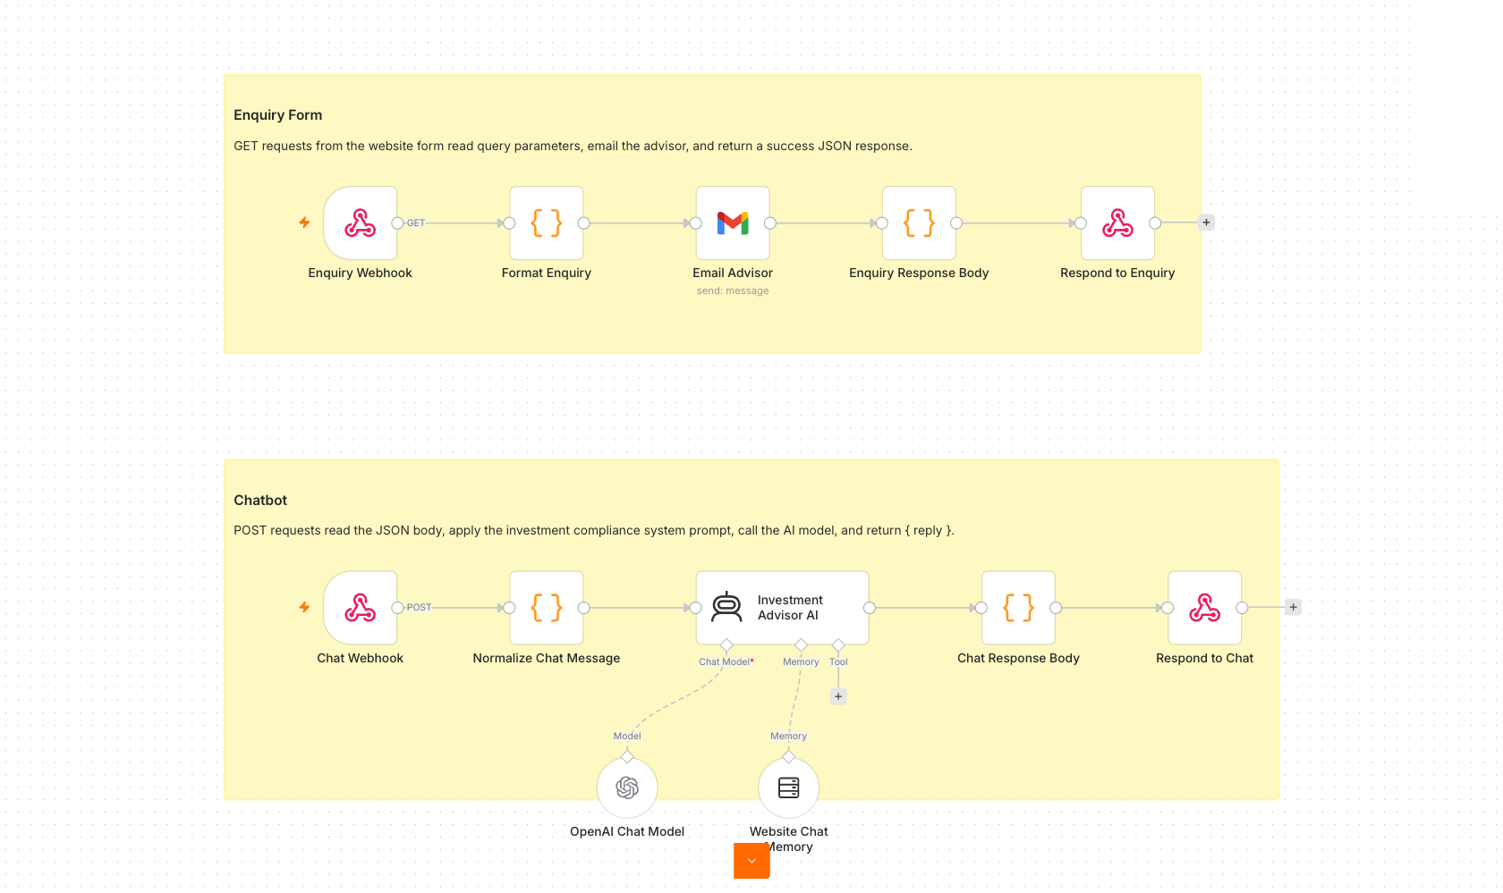
TOPIC 3 · LAB WORKFLOW
Activity 5 — Website Chatbot via Webhook (Investment Advisor)
Put your agent behind a public web page: the enquiry form and the floating chatbot both POST to one n8n webhook.
Webhook — POST
chat + enquiry form call it
AI Agent
compliance instruction — no advice
Respond to Webhook
reply returns to the page
Gmail
enquiry → advisor inbox
▶
▶
▶
ACT 5
Website Chatbot via Webhook (Investment Advisor)
Production URL pasted into script.js · CORS = * · workflow Active · steps in the Learner Guide
Agentic AI Automation with n8n · TGS-2023035977
© 2026 Tertiary Infotech Academy Pte Ltd
82

Slide 84
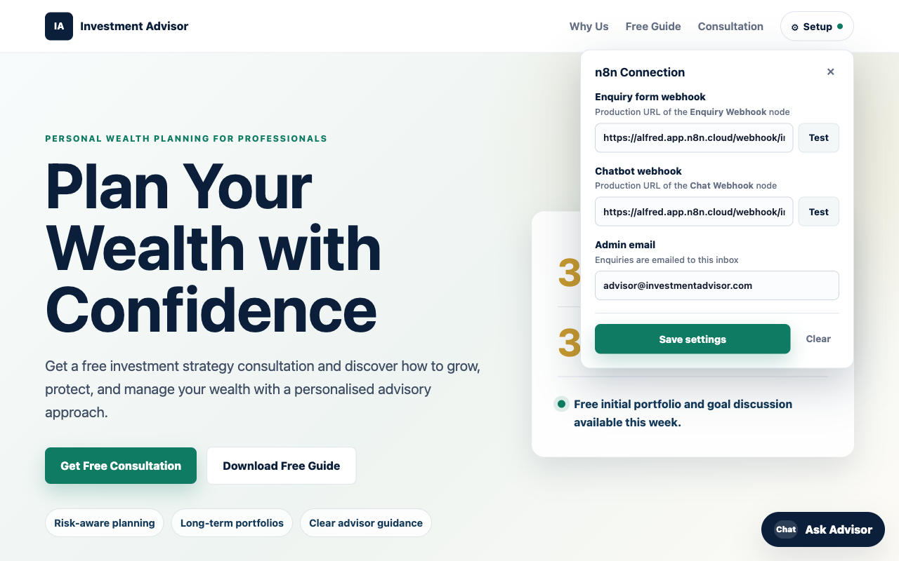
ACT 5 · THE WEBSITE
Activity 5 — The Investment Advisor Website
• A public landing page with an enquiry form and a floating 'Ask Advisor' chatbot.
• Both the form and the chat POST to one n8n Webhook.
• The AI Agent replies in the chat; the advisor is emailed the enquiry.
• Set the webhook Production URL in script.js, then open index.html.
Agentic AI Automation with n8n · TGS-2023035977
© 2026 Tertiary Infotech Academy Pte Ltd
83

Slide 85
Tea Break
15 minutes
Agentic AI Automation with n8n · TGS-2023035977
© 2026 Tertiary Infotech Academy Pte Ltd
84

Slide 86
04
TOPIC 4
APIs and the HTTP Request Node
Calling external services · request anatomy · status codes · API keys
Applied in Activity 6
Agentic AI Automation with n8n · TGS-2023035977
© 2026 Tertiary Infotech Academy Pte Ltd
85

Slide 87
TOPIC 4 · API & HTTP
What Is an API?
A service's front desk: you send a structured request over HTTP, it returns structured data — usually JSON.
Your workflow
the client
HTTP request
method + URL + key + params
API server
processes the request
JSON response
fields your next node can read
▶
▶
▶
1
Live data on demand
2
You dial out
3
One node fits all
Prices, weather, news, CRM records — data your workflow pulls the moment it needs it.
The opposite of a webhook: YOUR flow calls THEIR server, on your schedule.
The HTTP Request node calls any API on the internet — even ones n8n has no integration for.
If a service has an API, n8n can use it — the HTTP Request node is the universal connector.
Agentic AI Automation with n8n · TGS-2023035977
© 2026 Tertiary Infotech Academy Pte Ltd
86

Slide 88
TOPIC 4 · API & HTTP
Anatomy of an HTTP Request
Four parts you configure on the HTTP Request node.
Part
What it is
Activity 6 example
Method
GET (read) · POST (send) · PUT · DELETE
GET — read market candles
URL / endpoint
The address of the resource
api.twelvedata.com/time_series
Headers
Metadata, incl. authentication
(Twelve Data uses a query key instead)
Query params / body
The inputs you send
symbol=AAPL & interval=1min & apikey=…
Store API keys in Credentials — never hard-code them into the URL you share.
Agentic AI Automation with n8n · TGS-2023035977
© 2026 Tertiary Infotech Academy Pte Ltd
87

Slide 89
TOPIC 4 · API & HTTP
Reading the Response — Status Codes
The status code tells you whose problem it is before you read a single byte of the body.
1
2xx — success
2
401 / 403 — auth
200 OK, 201 Created. The JSON body holds your data — map it to the next node.
Bad or missing API key. Check the credential, not the flow.
3
429 — rate limited
4
4xx vs 5xx
Too many calls for your plan — slow down or upgrade. Free tiers hit this fast.
4xx: your request is wrong. 5xx: their server is broken. Retry helps only with 5xx.
4xx = fix your request · 5xx = wait and retry — never guess from the body alone.
Agentic AI Automation with n8n · TGS-2023035977
© 2026 Tertiary Infotech Academy Pte Ltd
88

Slide 90

TOPIC 4 · API & HTTP
The HTTP Request Node
HTTP Request node — configure method, URL, auth, query parameters; the JSON response flows to the next node
Agentic AI Automation with n8n · TGS-2023035977
© 2026 Tertiary Infotech Academy Pte Ltd
89

Slide 91
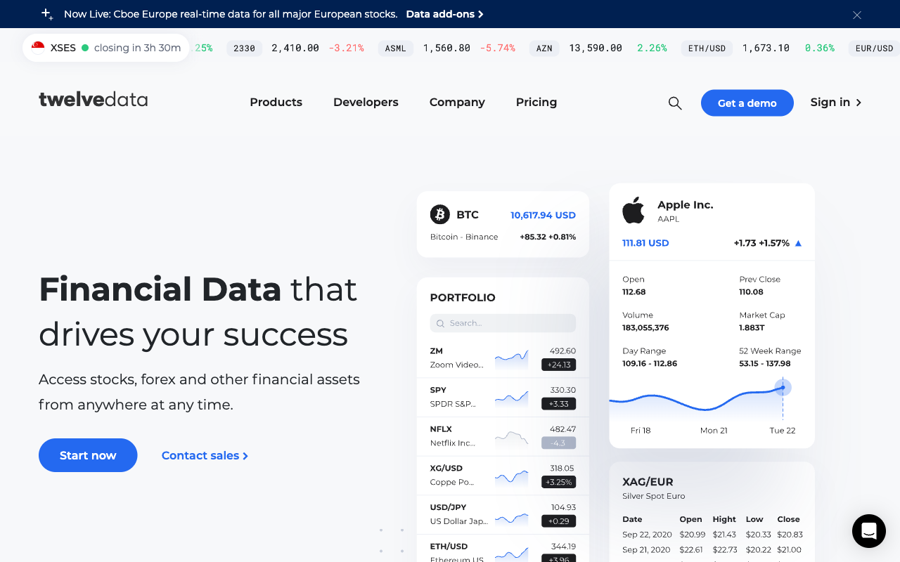
ACT 6 · MARKET DATA API
Twelve Data — Market Data API
• Live stock / forex / crypto data over a simple REST API.
• Sign up (free Basic plan), then Account → API Keys.
• Paste the apikey into the three 'candles' HTTP nodes.
• Free tier: 8 calls/min — enough for the lab.
Agentic AI Automation with n8n · TGS-2023035977
© 2026 Tertiary Infotech Academy Pte Ltd
90

Slide 92
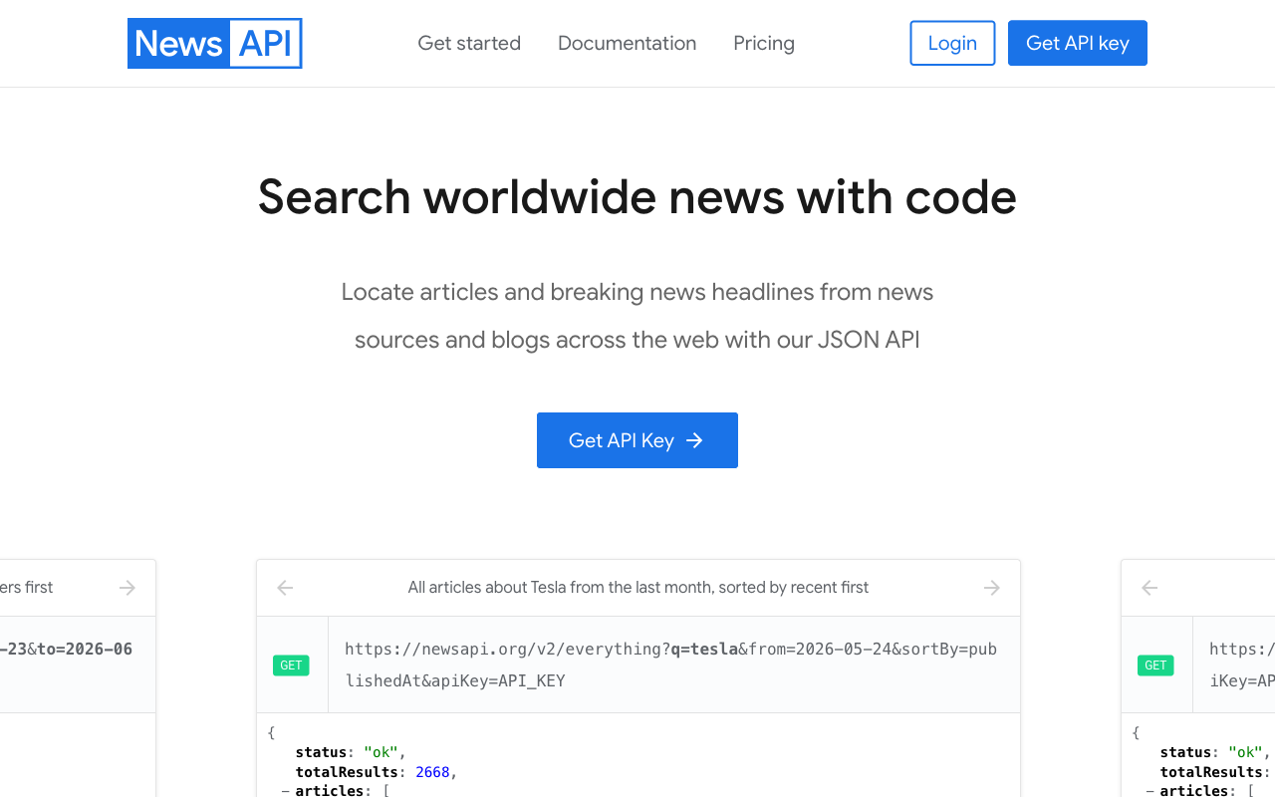
ACT 6 · NEWS API
NewsAPI — Headlines API
• Recent news articles for any search query.
• Register (free Developer plan) and copy your API key.
• Store it as a Query Auth credential (name = apiKey) on the news node.
• The agent reads sentiment from the headlines.
Agentic AI Automation with n8n · TGS-2023035977
© 2026 Tertiary Infotech Academy Pte Ltd
91

Slide 93
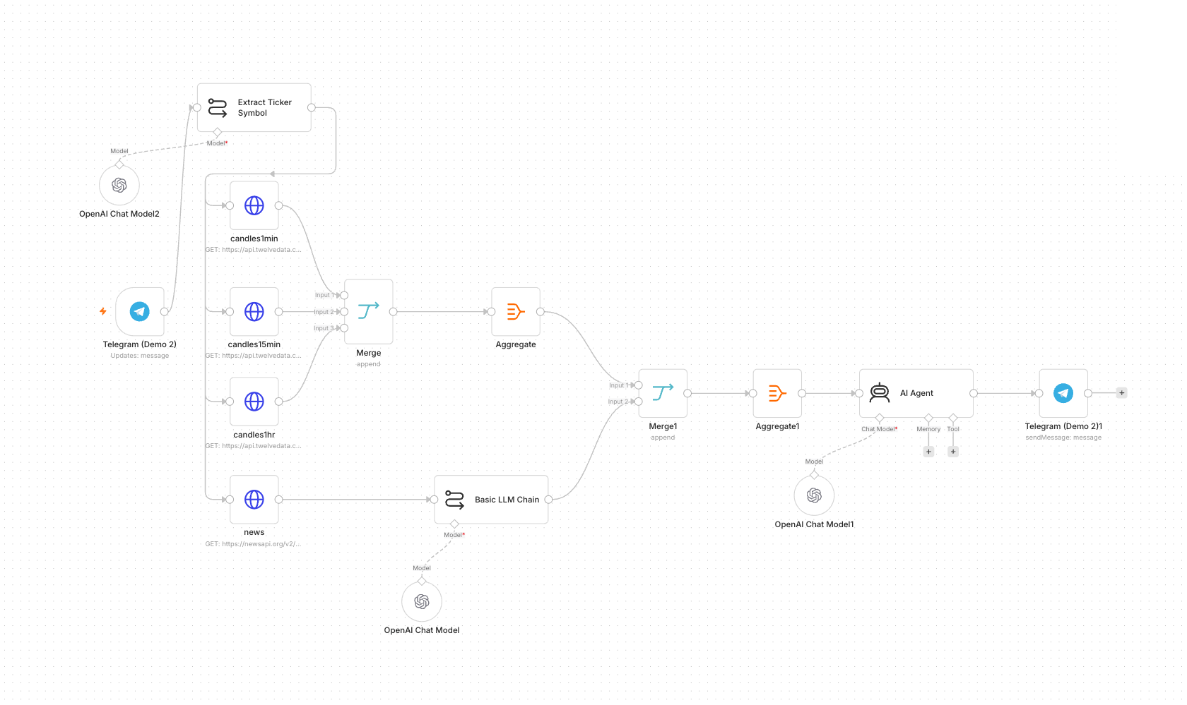
TOPIC 4 · LAB WORKFLOW
Activity 6 — Finance APIs → Telegram (AI Day-Trading Agent)
Ask the bot about a stock: it pulls candles on three timeframes plus news, and the agent argues a Buy / Sell / Hold call.
Telegram Trigger
'Should I buy AAPL?'
Code — Extract Ticker
AAPL
HTTP ×4
candles 1m / 15m / 1h + news
AI Agent
technicals + sentiment → call
Telegram — Send
recommendation + reasoning
▶
▶
▶
▶
ACT 6
Finance APIs → Telegram (AI Day-Trading Agent)
Twelve Data + NewsAPI keys · imported flow, re-select credentials · steps in the Learner Guide
Agentic AI Automation with n8n · TGS-2023035977
© 2026 Tertiary Infotech Academy Pte Ltd
92

Slide 94
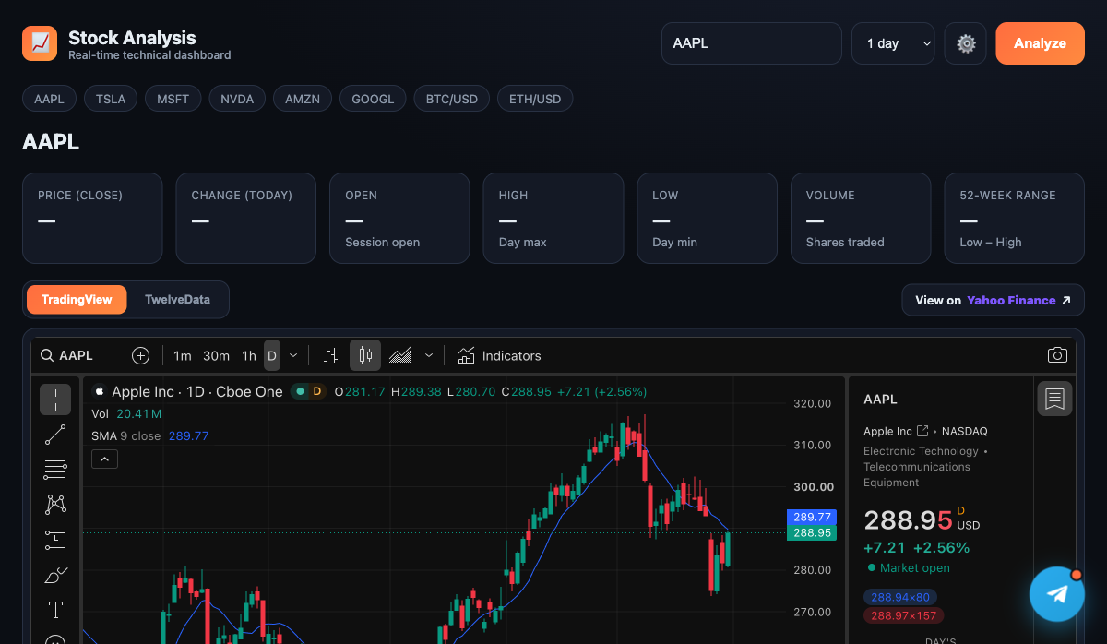
ACT 6 · THE WEBSITE
Activity 6 — The Stock Analysis Dashboard
• A real-time dashboard with a live TradingView candlestick chart.
• Quote stats (price, change, OHLC, volume, 52-week range) from Twelve Data.
• A floating Telegram chat widget opens the AI day-trading agent.
• Save your Twelve Data key + bot username in the Settings panel.
Agentic AI Automation with n8n · TGS-2023035977
© 2026 Tertiary Infotech Academy Pte Ltd
93

Slide 95
WRAP-UP
End of Day 2 — Recap
• You exposed an AI agent to a public website via a webhook (Production URL + CORS).
• You pulled live market and news data through APIs into a Telegram agent.
• Tomorrow: RAG at production scale, human-in-the-loop, guardrails, and the capstone.
Agentic AI Automation with n8n · TGS-2023035977
© 2026 Tertiary Infotech Academy Pte Ltd
94

Slide 96
Lunch Break
1 hour
Agentic AI Automation with n8n · TGS-2023035977
© 2026 Tertiary Infotech Academy Pte Ltd
95

Slide 97
05
TOPIC 5
Retrieval-Augmented Generation
Why retrieval · embeddings and vector stores · chunking and top_k · production vector DBs
Applied in Activities 7a and 7b
Agentic AI Automation with n8n · TGS-2023035977
© 2026 Tertiary Infotech Academy Pte Ltd
96

Slide 98
TOPIC 5 · RAG
Why Retrieval, Rather Than a Bigger Prompt
You could paste all your documents into the instruction — until you can't.
Everything in the prompt
Retrieve, then generate
Beyond a point the model ignores the middle. Every question pays tokens for ALL documents. Add document #41 and quality quietly drops.
Find the two or three chunks that resemble the question and give the model ONLY those. Cost stays flat as the library grows.
Question
embed it
Search the store
nearest chunks
Paste into the prompt
only what matched
Grounded answer
cites what it saw
▶
▶
▶
RAG = retrieval + generation. The retrieval decides whether the generation can possibly be right.
Agentic AI Automation with n8n · TGS-2023035977
© 2026 Tertiary Infotech Academy Pte Ltd
97

Slide 99
TOPIC 5 · RAG
The RAG Pipeline — Ingest Once, Retrieve Every Question
Two phases: ingestion happens once per document; retrieval happens on every question.
INGESTION — once
Documents
Chunk
Embed
Store as vectors
▶
▶
▶
RETRIEVAL — every question
Question
Embed
Nearest top_k
Into the prompt
Answer
▶
▶
▶
▶
Chunk
Embedding
Similarity
top_k
How a document is split — here one brochure = one chunk.
Text as a list of numbers; similar meaning → nearby vectors.
Nearness of two vectors — how 'related' two texts are.
How many chunks come back per question — 3 here.
Four words — chunk, embedding, similarity, top_k — explain every RAG behaviour you will see.
Agentic AI Automation with n8n · TGS-2023035977
© 2026 Tertiary Infotech Academy Pte Ltd
98

Slide 100
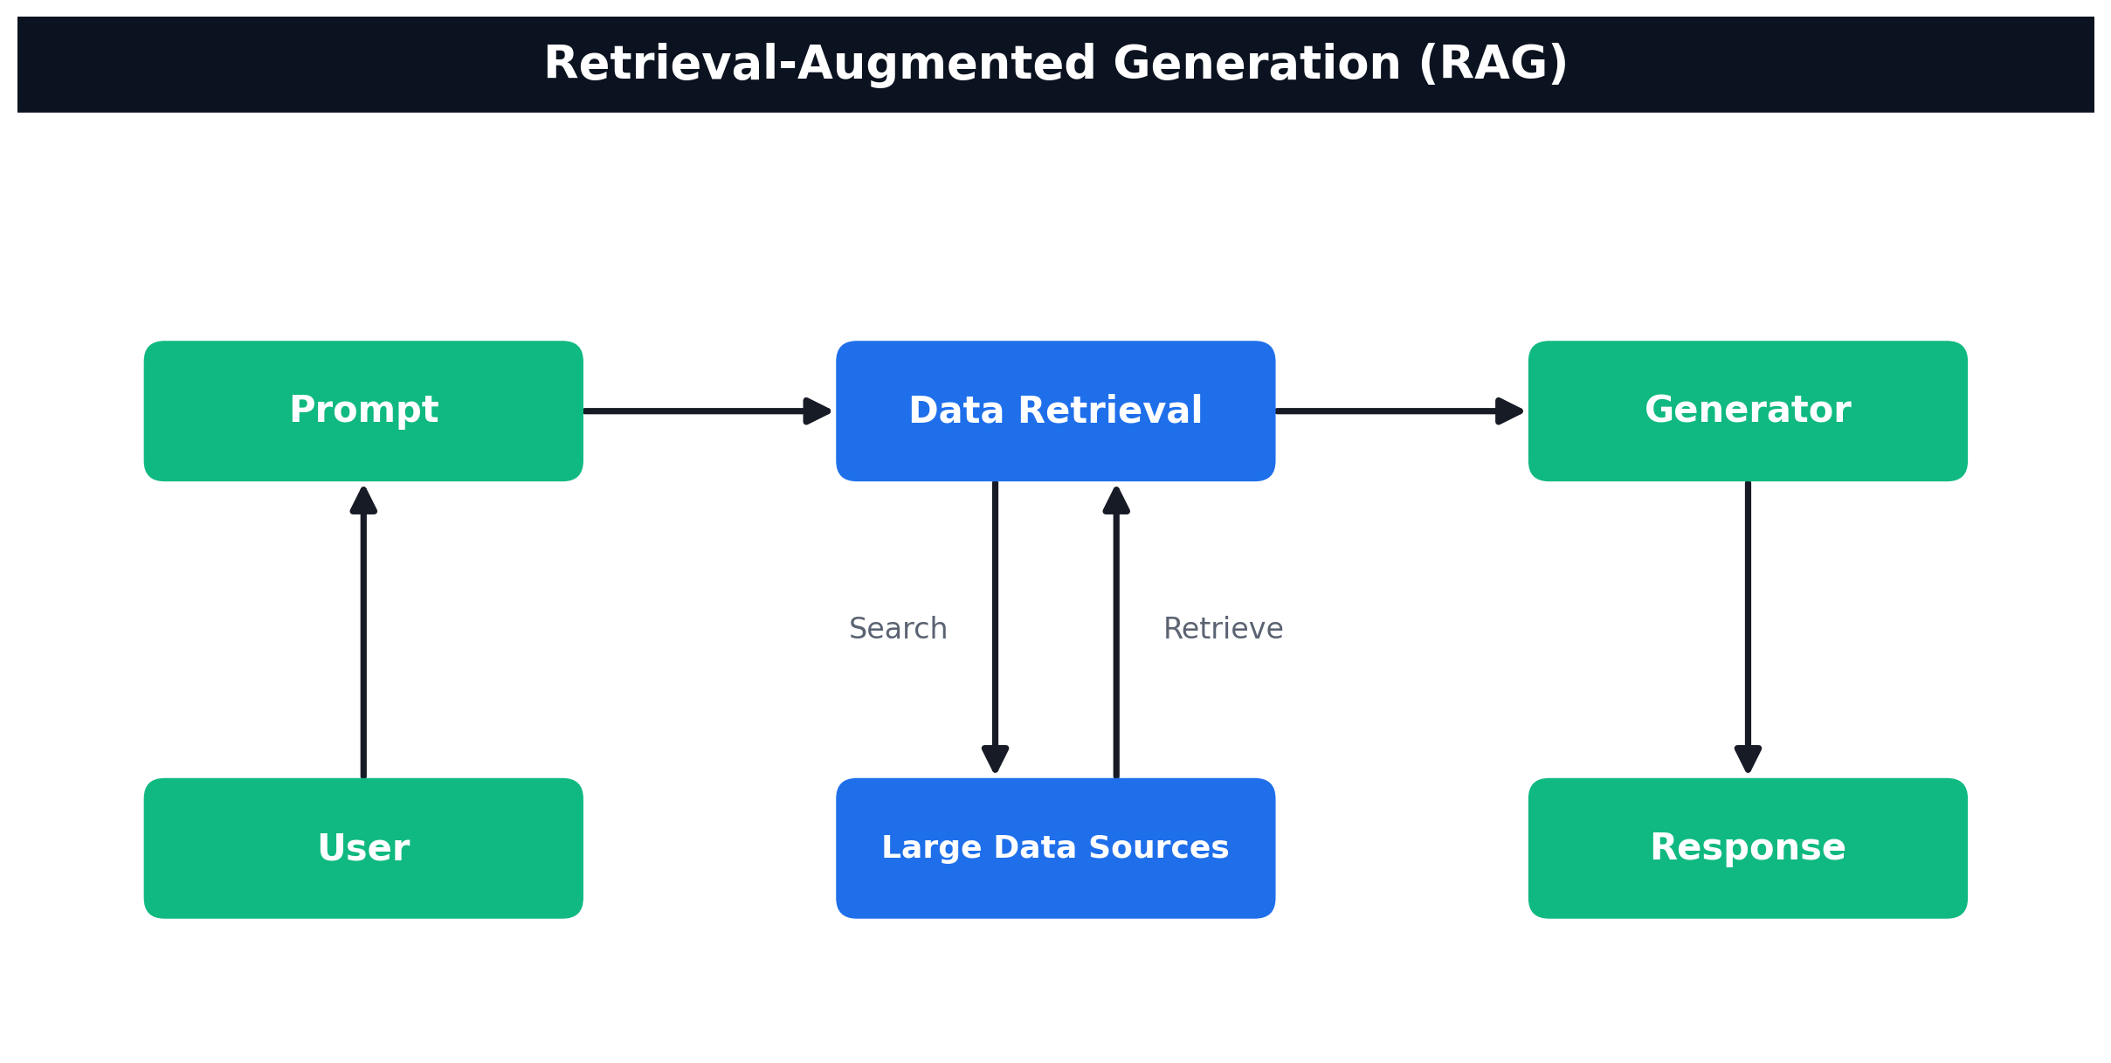
TOPIC 5 · RAG
How RAG Works
User → Prompt → Data Retrieval (search/retrieve over your data sources) → Generator → Response
Agentic AI Automation with n8n · TGS-2023035977
© 2026 Tertiary Infotech Academy Pte Ltd
99

Slide 101
TOPIC 5 · RAG
Vector Databases — Where the Embeddings Live
In-memory for demos; a hosted store for anything that must survive a restart.
Supabase (pgvector)
Pinecone
Qdrant
What it is
Postgres + extension
Managed SaaS index
Open-source vector DB
Setup
SQL table + function
Create an index — no schema
Docker or Qdrant Cloud
Best for
Teams already on Postgres
Zero-ops, scales fast
Full control, self-hosted
Course embedding
OpenAI 1536-dim
Gemini 3072-dim
OpenAI 1536-dim
THE DIMENSION RULE
The store's dimension MUST equal the embedding model's output — OpenAI text-embedding-3-small = 1536, Gemini gemini-embedding-001 = 3072. Mismatched dimensions are the #1 cause of failed inserts.
Swap the store, keep the RAG flow — but ingestion and retrieval must use the SAME embedding model.
Agentic AI Automation with n8n · TGS-2023035977
© 2026 Tertiary Infotech Academy Pte Ltd
100

Slide 102
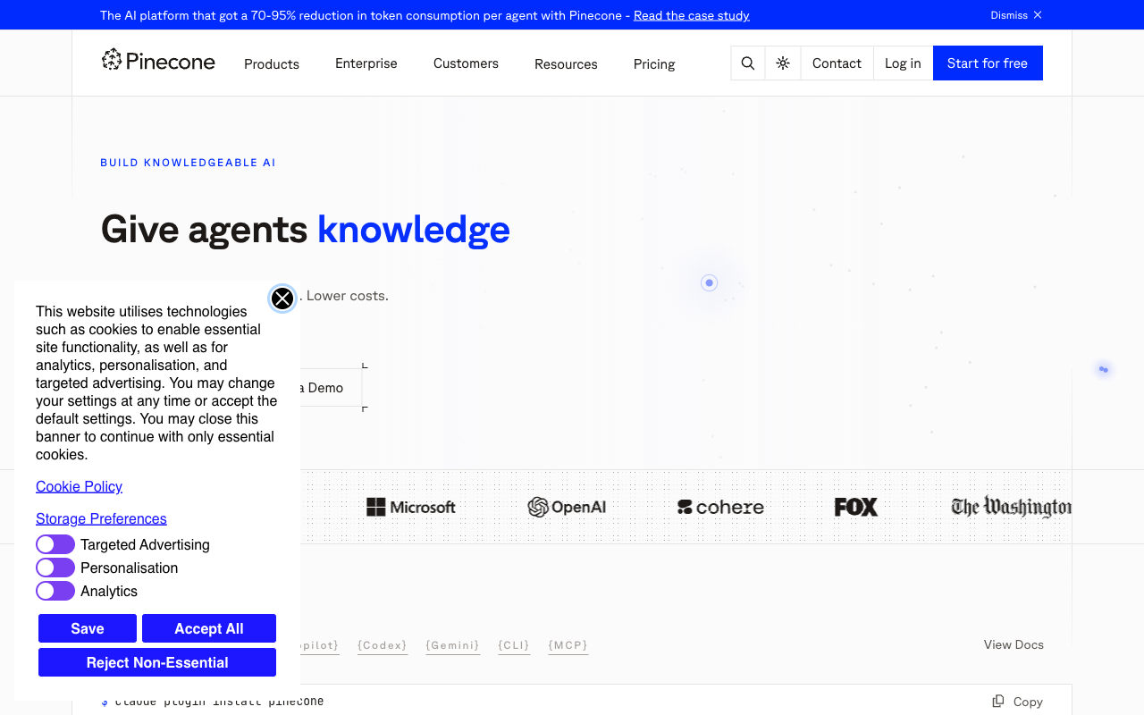
ACT 7b · VECTOR DATABASE
Pinecone — Example Managed Store
• Pinecone is a managed (cloud) vector database for RAG.
• Free 'Starter' tier is enough for this lab.
• Create an index: Dimensions = 3072 (Gemini), Metric = cosine.
• Upload and retrieval must use the same namespace.
Agentic AI Automation with n8n · TGS-2023035977
© 2026 Tertiary Infotech Academy Pte Ltd
101

Slide 103
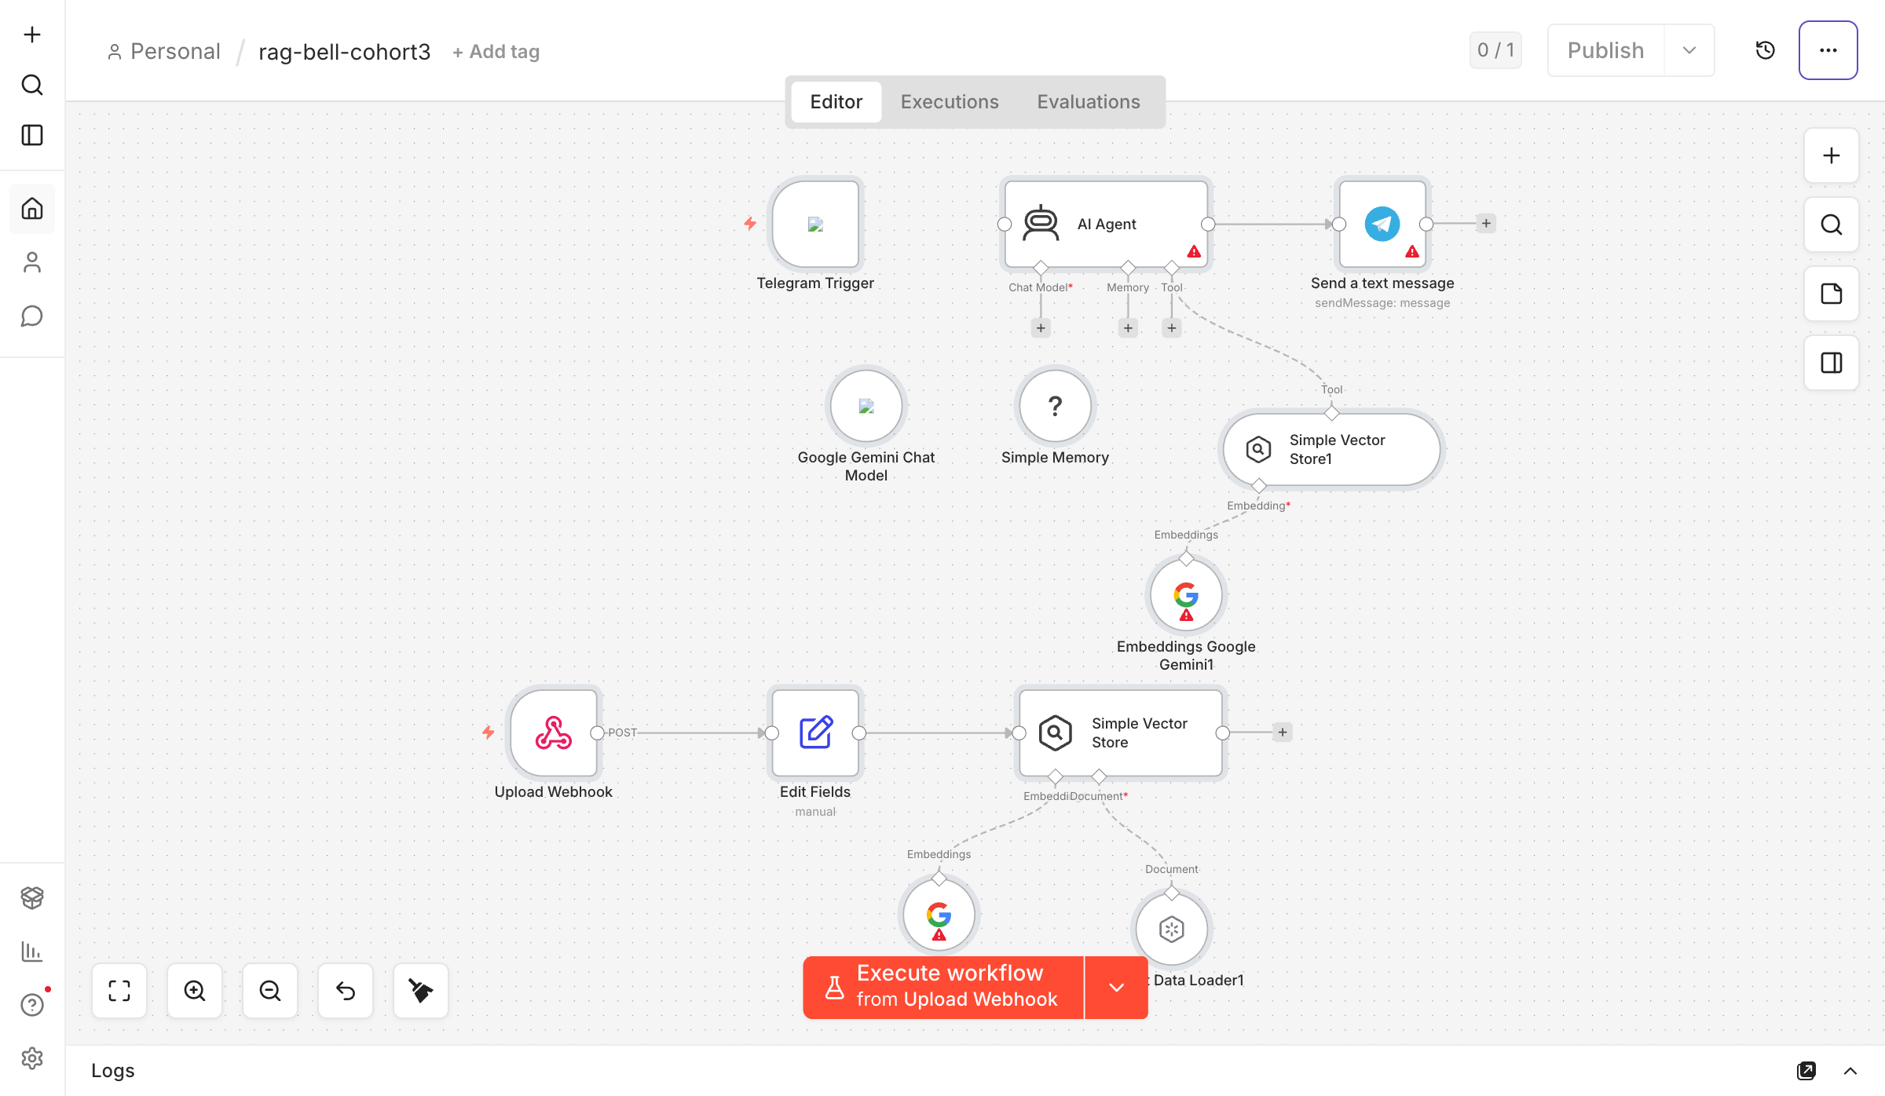
TOPIC 5 · LAB WORKFLOW
Activity 7a — RAG Chatbot: Upload a PDF, Ask in Telegram
The full RAG loop, no code: a web page ingests your IT-Support FAQ; a Telegram bot answers only from that document.
Web Uploader
PDF text extracted in browser
Upload Webhook
POST to n8n
Gemini Embeddings
chunk + embed
Vector Store
in-memory; replaced per upload
▶
▶
▶
Telegram Trigger
'How do I reset my password?'
AI Agent
knowledge_base retriever tool
Telegram — Send
answers only from the document
▶
▶
ACT 7a
RAG Chatbot: Upload a PDF, Ask in Telegram
Gemini credential on 3 nodes · off-topic questions are refused · steps in the Learner Guide
Agentic AI Automation with n8n · TGS-2023035977
© 2026 Tertiary Infotech Academy Pte Ltd
102

Slide 104
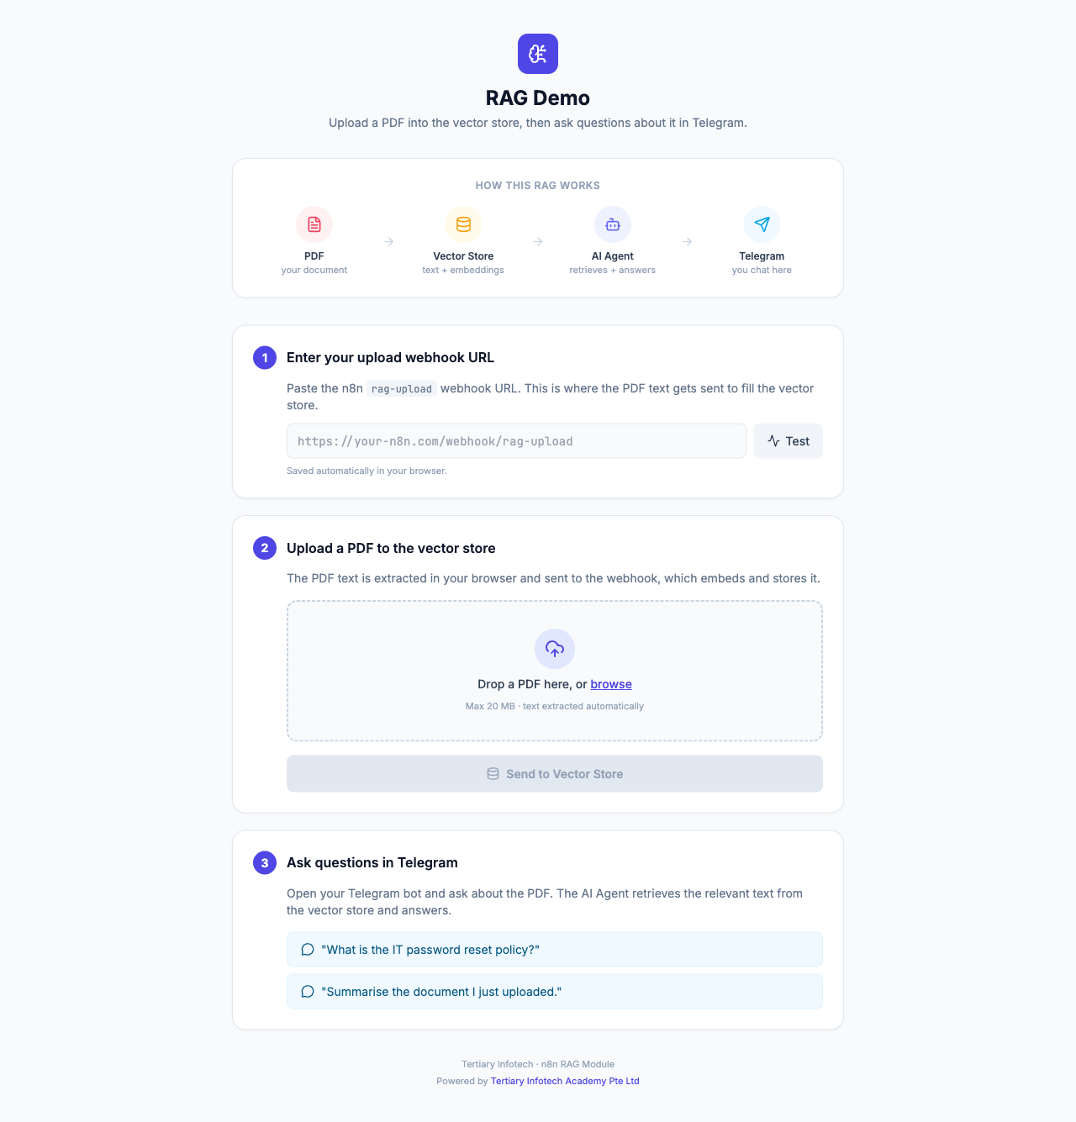
ACT 7a · INGESTION
Activity 7a — The Upload Page
• A single-page uploader extracts PDF text in the browser with PDF.js.
• Paste your n8n rag-upload webhook URL and click Test.
• Drop the IT-Support FAQ PDF and Send to Vector Store to ingest it.
• No build step — just open the HTML file.
Agentic AI Automation with n8n · TGS-2023035977
© 2026 Tertiary Infotech Academy Pte Ltd
103

Slide 105
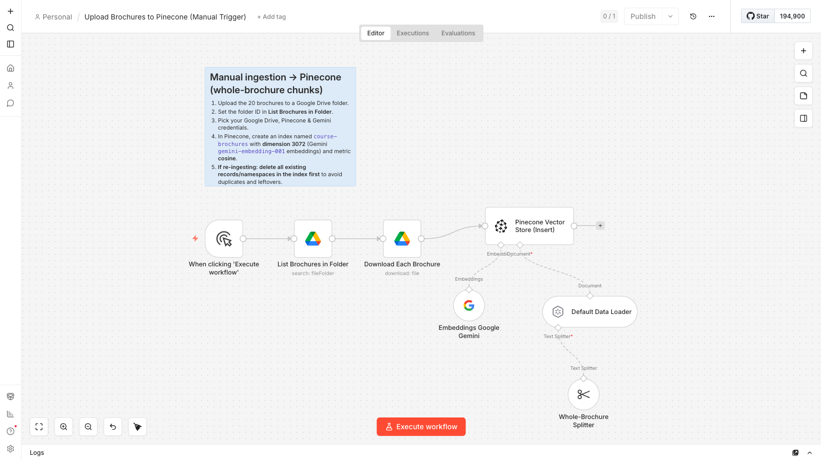
TOPIC 5 · LAB WORKFLOW
Activity 7b — Ingestion: 20 Brochures into a Vector DB
Cook & Bake Academy: load 20 course brochures from Google Drive into your chosen vector database — run once.
Manual Trigger
run once
Google Drive
list + download 20 brochures
Split + Embed
1 brochure = 1 chunk · Gemini 3072-d
Vector Store — Insert
index: course-brochures
▶
▶
▶
Shown: Pinecone ingestion. Supabase & Qdrant flows are identical except the store node + OpenAI 1536-d embeddings.
ACT 7b
Ingestion: 20 Brochures into a Vector DB
Choose Supabase / Pinecone / Qdrant · 20 vectors after the run · steps in the Learner Guide
Agentic AI Automation with n8n · TGS-2023035977
© 2026 Tertiary Infotech Academy Pte Ltd
104

Slide 106
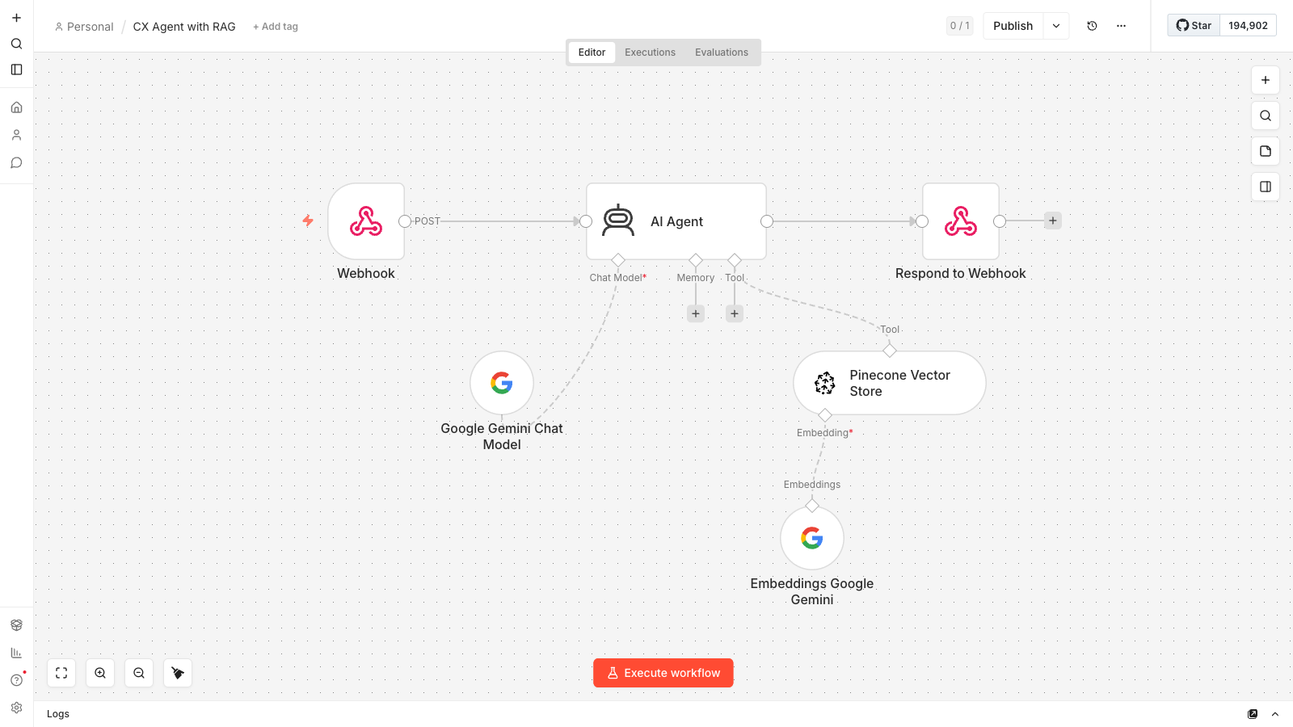
TOPIC 5 · LAB WORKFLOW
Activity 7b — CX Agent: Grounded Support Chatbot
The answering half: the website chat widget POSTs each question; the agent retrieves matching brochures and answers grounded.
Webhook — POST
website chat widget
AI Agent
Pinecone retriever tool + Gemini
Respond to Webhook
grounded answer to the widget
▶
▶
ACT 7b
CX Agent: Grounded Support Chatbot
Same index, same embeddings, same namespace as ingestion · steps in the Learner Guide
Agentic AI Automation with n8n · TGS-2023035977
© 2026 Tertiary Infotech Academy Pte Ltd
105

Slide 107

ACT 7b · THE WEBSITE
Cook & Bake Academy — Support Chatbot
• The Cook & Bake Academy site with the course assistant open.
• Visitors ask about any course — duration, fee, location, schedule.
• Answers are grounded in the 20 ingested brochures.
• Set WEBHOOK_URL in script.js to your n8n CX Agent Production URL.
Agentic AI Automation with n8n · TGS-2023035977
© 2026 Tertiary Infotech Academy Pte Ltd
106

Slide 108
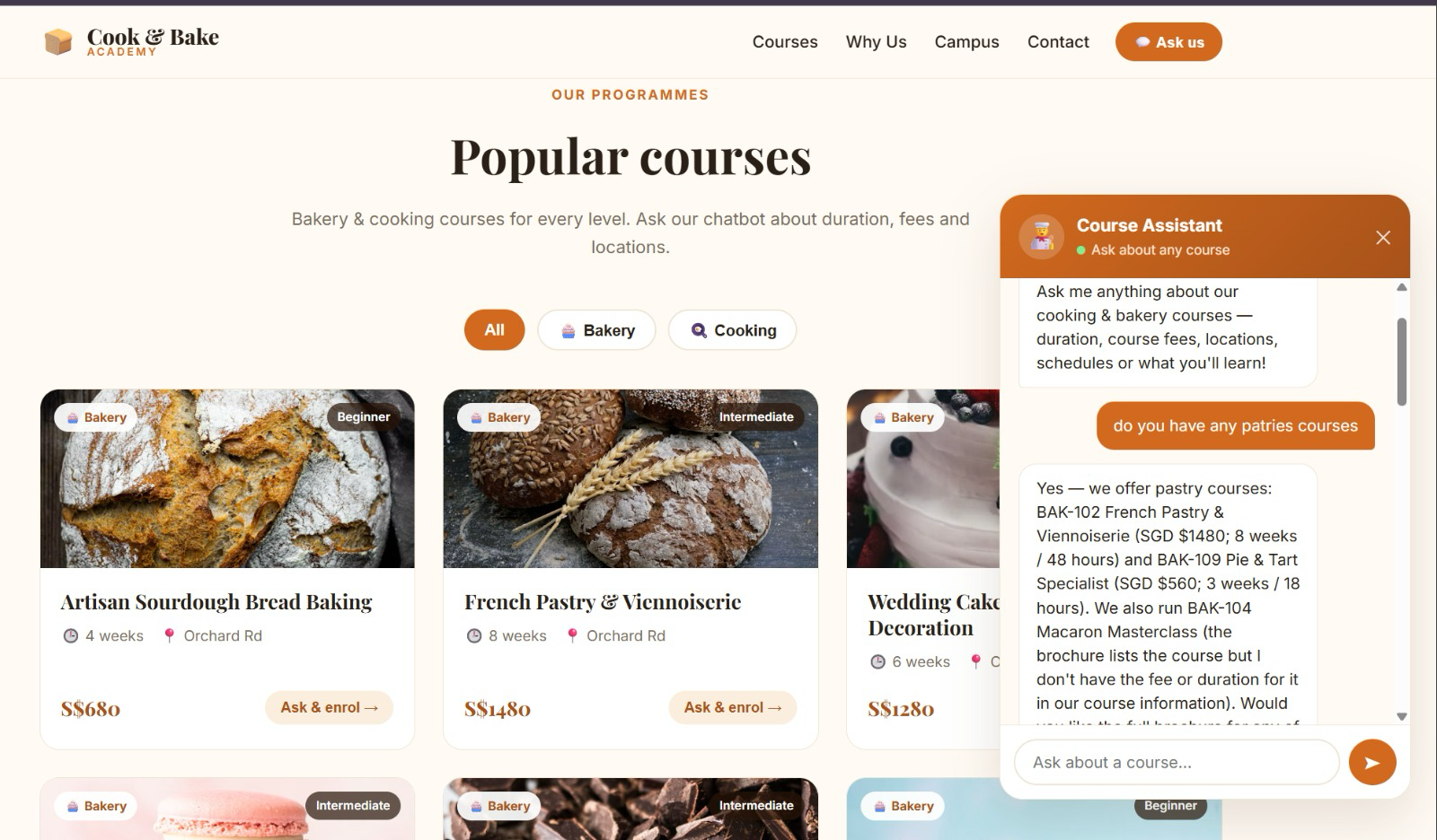
ACT 7b · THE WEBSITE
Activity 7b — The Course Assistant in Action
A real conversation on the Cook & Bake Academy site. Every fee in the reply came from a retrieved brochure.
1
A typo still finds it
The visitor typed 'patries'. Embeddings match meaning, not spelling, so the pastry brochures BAK-102 and BAK-109 still come back.
2
Facts quoted, not invented
Fees and durations are quoted exactly: BAK-102 is SGD $1480 for 8 weeks / 48 hours — the same S$1480 shown on the course card behind the chat.
3
It admits a gap
It did not give BAK-104's fee and said so instead of guessing. The brochure does list SGD $420, so check what the tool returned: that is a retrieval gap.
'I don't have that' is grounding working — fix gaps in retrieval, never by loosening the prompt.
Agentic AI Automation with n8n · TGS-2023035977
© 2026 Tertiary Infotech Academy Pte Ltd
107

Slide 109
Tea Break
15 minutes
Agentic AI Automation with n8n · TGS-2023035977
© 2026 Tertiary Infotech Academy Pte Ltd
108

Slide 110
06
TOPIC 6
Security, Human-in-the-Loop & Guardrails
Where the human belongs · approval gates · input and output guardrails
Applied in Activities 8a, 8b and 8c
Agentic AI Automation with n8n · TGS-2023035977
© 2026 Tertiary Infotech Academy Pte Ltd
109

Slide 111
TOPIC 6 · SECURITY & GOVERNANCE
Human In, On, and Out of the Loop
Three arrangements people use interchangeably — and they are not the same thing.
Pattern
Who decides
Who acts
Can AI proceed alone?
Human IN the loop
AI proposes, human decides
Human approves, system acts
NO — it blocks
Human ON the loop
AI decides and acts
Human monitors, can intervene
Yes — reviewed after
Human OUT of the loop
AI decides and acts
AI acts
Yes — nobody checks
WHERE THIS COURSE PUTS THE HUMAN
Activity 8a — the manager approves leave before any email goes to the employee (IN the loop). The dashboard (8b) and chatbot (8c) run alone, but the chatbot is fenced by guardrails on both sides.
Ask who pays for the mistake — that answer sizes the agent's authority and places the human.
Agentic AI Automation with n8n · TGS-2023035977
© 2026 Tertiary Infotech Academy Pte Ltd
110

Slide 112
TOPIC 6 · SECURITY & GOVERNANCE
How an Approval Suspends a Running Flow
n8n's Send and Wait for Response physically pauses the workflow until a person clicks.
Request submitted
employee applies for leave
Send & Wait
manager gets Approve / Decline email
The run SUSPENDS
minutes or days — it waits
A person responds
one click in the email
IF reads the outcome
approved → notify · declined → notify
▶
▶
▶
▶
Outcome = Approve
Outcome = Decline
Ack first
Send the approval email, update the record, continue the business process.
Send the rejection with the manager's comments — never silence.
The portal gets an instant 'received' response BEFORE the wait — the browser never hangs on a manager.
A pause that is still paused tomorrow is a real gate — that is the deliverable of Activity 8a.
Agentic AI Automation with n8n · TGS-2023035977
© 2026 Tertiary Infotech Academy Pte Ltd
111

Slide 113
TOPIC 6 · SECURITY & GOVERNANCE
Guardrails — Two Gates Around the Agent
An LLM checks every message in, and every reply out — the agent only sees and says what passes.
User message
from the HR portal
INPUT guardrail
LLM: ALLOW / BLOCK
HR AI Agent
answers in-scope questions
OUTPUT guardrail
LLM: SAFE / LEAK
Reply or blocked
user sees the safe path
▶
▶
▶
▶
1
Input (pre) guardrail blocks
2
Output (post) guardrail blocks
Prompt injection ('ignore previous instructions'), jailbreaks, requests for another person's salary or private data.
Salary figures, NRIC, credentials, system-instruction leaks — even when the agent was tricked into producing them.
Instructions say what the agent SHOULD do; guardrails enforce what it MUST NOT — you need both.
Agentic AI Automation with n8n · TGS-2023035977
© 2026 Tertiary Infotech Academy Pte Ltd
112

Slide 114
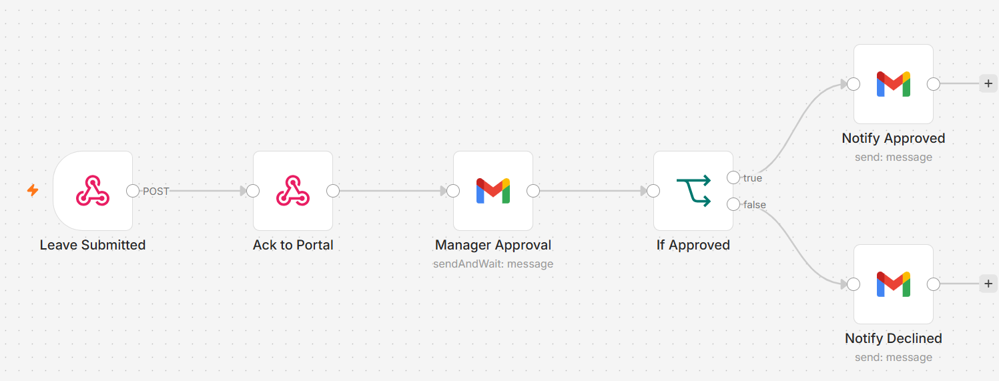
TOPIC 6 · LAB WORKFLOW
Activity 8a — Leave Application & Manager Approval (HITL)
The employee applies on the portal; the flow acks, then suspends until the manager clicks Approve or Decline in email.
Webhook — POST
hr-leave-apply
Respond — Ack
portal gets instant OK
Gmail — Send & Wait
manager: Approve / Decline
IF
approved = true ?
Gmail
notify the employee
▶
▶
▶
▶
ACT 8a
Leave Application & Manager Approval (HITL)
Human-in-the-loop gate · run suspends until the click · steps in the Learner Guide
Agentic AI Automation with n8n · TGS-2023035977
© 2026 Tertiary Infotech Academy Pte Ltd
113

Slide 115
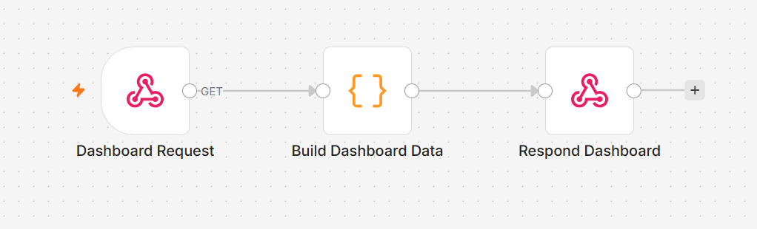
TOPIC 6 · LAB WORKFLOW
Activity 8b — HR Dashboard Data (GET Webhook)
A GET webhook powers the portal's Dashboard tab — leave balance and history returned as JSON to the browser.
Webhook — GET
hr-dashboard?email=…
Code
build the leave-data JSON
Respond to Webhook
JSON back to the portal
▶
▶
ACT 8b
HR Dashboard Data (GET Webhook)
GET query read from $json.query.email · CORS = * · steps in the Learner Guide
Agentic AI Automation with n8n · TGS-2023035977
© 2026 Tertiary Infotech Academy Pte Ltd
114

Slide 116
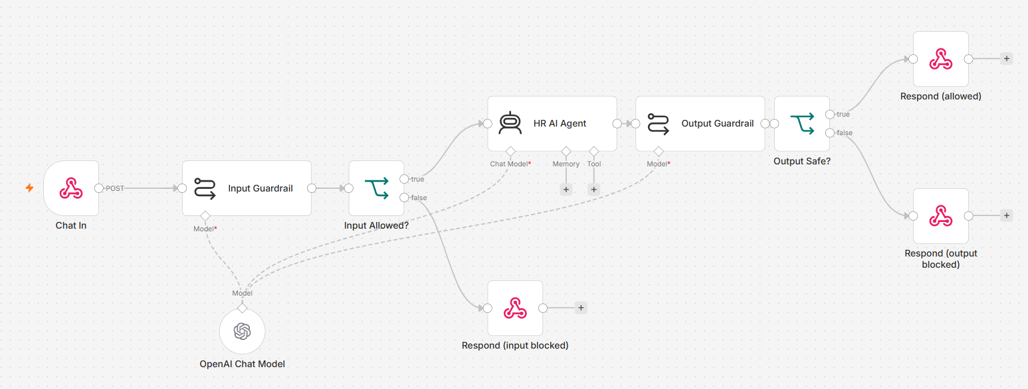
TOPIC 6 · LAB WORKFLOW
Activity 8c — AI Chatbot with Input & Output Guardrails
HR Buddy answers general HR questions — every message passes the input gate, every reply passes the output gate.
Webhook — POST
hr-chat
Input Guardrail
LLM: ALLOW / BLOCK
HR AI Agent
leave · payroll · claims
Output Guardrail
LLM: SAFE / LEAK
Respond
reply or blocked message
▶
▶
▶
▶
ACT 8c
AI Chatbot with Input & Output Guardrails
Test it by trying to break it — the injection probe must be blocked · steps in the Learner Guide
Agentic AI Automation with n8n · TGS-2023035977
© 2026 Tertiary Infotech Academy Pte Ltd
115

Slide 117
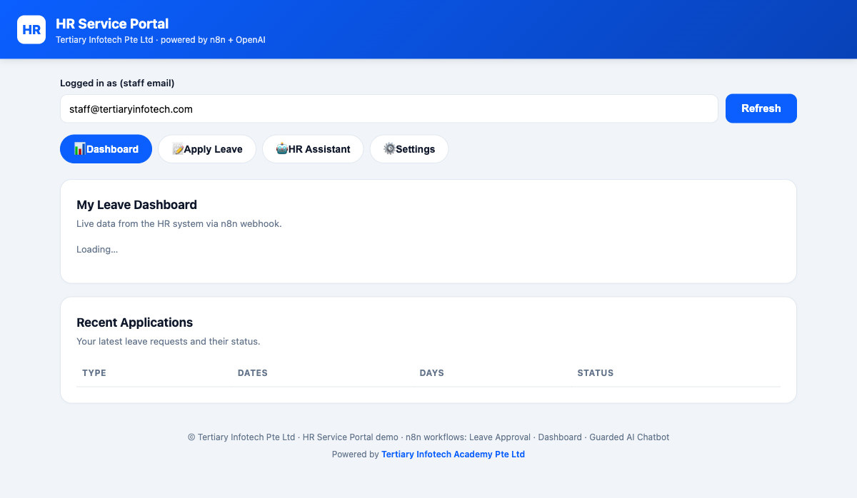
ACT 8 · THE WEBSITE
Activity 8 — The HR Service Portal
• One portal with four tabs: Dashboard, Apply Leave, HR Assistant, Settings.
• Dashboard pulls live leave balance & history from the GET webhook (8b).
• Apply Leave triggers the human-in-the-loop approval chain (8a).
• HR Assistant is the guarded AI chatbot — input & output guardrails (8c).
Agentic AI Automation with n8n · TGS-2023035977
© 2026 Tertiary Infotech Academy Pte Ltd
116

Slide 118
Lunch Break
1 hour
Agentic AI Automation with n8n · TGS-2023035977
© 2026 Tertiary Infotech Academy Pte Ltd
117

Slide 119
07
TOPIC 7
Mini Capstone Project
Describe it · n8n Assistant builds it · review · present
Everything from Activities 1–8 — built with AI-assisted workflow creation
Agentic AI Automation with n8n · TGS-2023035977
© 2026 Tertiary Infotech Academy Pte Ltd
118

Slide 120
TOPIC 7 · MINI CAPSTONE
Your Capstone — Let n8n Assistant Build It
In small groups, pick one end-to-end business process, describe it to n8n Assistant, then review, test and own the workflow it builds.
Pick a process
one painful, repeatable job
Write the prompt
trigger → steps → output
n8n Assistant builds
plan, nodes, wiring
You review & connect
credentials, Gateway credits
Test, add a control
guardrail or approval
Present
demo + 3–5 min talk
▶
▶
▶
▶
▶
1
A trigger
2
An AI agent
3
Data or storage
4
A control
Form, webhook, Telegram or schedule — who or what starts your process?
With at least one tool or a RAG source — the judgement in the middle.
An API you call, or storage you write — Sheets, a vector DB, a Data Table.
A guardrail or a human-in-the-loop step — decide where the human belongs and defend it.
Deliverables: the prompt(s) you used, a working workflow (.json), a short demo and a 3–5 minute presentation.
Agentic AI Automation with n8n · TGS-2023035977
© 2026 Tertiary Infotech Academy Pte Ltd
119

Slide 121
TOPIC 7 · MINI CAPSTONE
Step 1: Describe Your Process to n8n Assistant
Open Assistant in the left sidebar (or Build with AI on an empty canvas) and answer 'What do you want to automate?'
1
Say what starts it
Name the trigger and its inputs — 'a form where I enter a topic, audience and length'.
2
List the steps in order
Number them. One step per line becomes one node or one AI step on the canvas.
3
Say where the human decides
Ask for an approval gate before anything is published, sent or paid.
A numbered prompt gives a numbered workflow — the clearer the steps, the closer the first draft.
Agentic AI Automation with n8n · TGS-2023035977
© 2026 Tertiary Infotech Academy Pte Ltd
120

Slide 122
TOPIC 7 · MINI CAPSTONE
Example: An End-to-End Video Creation Workflow
One prompt turns a topic into a published video — research, script, production and publishing, with a human approval gate.
Topic
form: topic, audience, length
Research
AI Agent + web search
Video script
hook · 3 points · CTA
Video production
video API via HTTP Request
Publish
approve, then YouTube upload
▶
▶
▶
▶
THE PROMPT
THEN YOU
Create an end-to-end workflow that turns a topic into a published YouTube video:
1. Start from a form where I enter a video topic, target audience and length (60–90 seconds).
2. Research the topic on the web and summarise 5 key facts with their sources.
3. Write a video script from the research: a hook, 3 key points and a call to action, under 200 words.
4. Send the script to a video-generation API with an HTTP Request node, and wait until the video is ready.
5. Email me the script and the video link, and wait for my approval.
6. If approved, upload the video to YouTube with a title, description and tags;
if rejected, log my feedback in a Google Sheet.
Use Gateway credits for the AI models. Ask me before publishing.
• Review the plan before it builds
• Add your video API key as a credential (e.g. HeyGen, Runway or Google Veo)
• Connect Gmail, Google Sheets and YouTube
• Test with a real topic — approve the draft video
The AI writes and produces; the workflow runs it — and nothing is published until a person approves it.
Agentic AI Automation with n8n · TGS-2023035977
© 2026 Tertiary Infotech Academy Pte Ltd
121

Slide 123
TOPIC 7 · MINI CAPSTONE
More Example Prompts for Your Capstone
Start from one of these, or write your own. Each names the trigger, numbers the steps and puts a human at the risky step.
Weekly newsletter
Invoice processing
Customer-support triage
1. Every Monday at 9am, search the web for this week's news on <your industry>.
2. Pick the 5 most relevant stories and write a short newsletter with a summary and link for each.
3. Email me the draft for approval; if approved, send it to the subscribers in my Google Sheet.
1. When an email with a PDF invoice arrives in Gmail, extract the supplier, invoice number, date and amount.
2. Add a row to my Invoices Google Sheet.
3. If the amount is over $5,000, email the finance manager to approve before marking it 'ready to pay'.
1. From a website chat webhook, classify each message as billing, technical or sales.
2. Answer FAQs from my policy documents (RAG); never invent a price.
3. Hand anything else to a human by posting it to Telegram, and log every conversation.
Then refine in the same chat: 'add an approval step', 'use Gateway credits', 'log every run to a Google Sheet'.
Agentic AI Automation with n8n · TGS-2023035977
© 2026 Tertiary Infotech Academy Pte Ltd
122

Slide 124
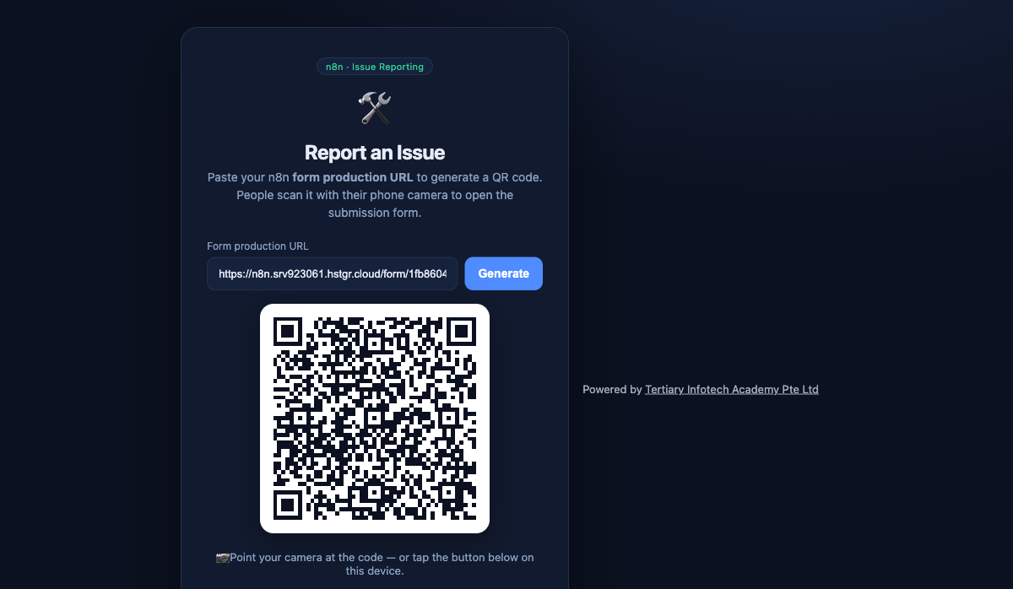
TOPIC 7 · WORKED EXAMPLE
Capstone Example — Issue Reporting
• Paste your n8n Form production URL to generate a QR code.
• People scan the QR with a phone to open the submission form.
• Submissions (with photos) flow into Postgres and a public gallery.
• A complete worked capstone you can adapt for your own project.
Agentic AI Automation with n8n · TGS-2023035977
© 2026 Tertiary Infotech Academy Pte Ltd
123

Slide 125
WRAP-UP
Presentation & Assessment
• Present the problem, your design, and what you'd improve.
• Written Assessment (SAQ) — 1 hour · Practical Performance (PP) — 1 hour.
• Open book: slides, Learner Guide and approved materials.
• Remember to take the Assessment digital attendance (TRAQOM).
Agentic AI Automation with n8n · TGS-2023035977
© 2026 Tertiary Infotech Academy Pte Ltd
124

Slide 126
FINAL ASSESSMENT
Assessment
• Written Assessment (SAQ) — 1 hour. Practical Performance (PP) — 1 hour.
• Open book: slides, Learner Guide and approved materials only.
• Remember to take the Assessment digital attendance (TRAQOM).
• Submit your completed answers on the LMS at https://lms-tms.tertiaryinfotech.com/.
Agentic AI Automation with n8n · TGS-2023035977
© 2026 Tertiary Infotech Academy Pte Ltd
125

Slide 127
ON ASSESSMENT DAY
Assessment Flow
1
2
3
4
5
▶
▶
▶
▶
TRAQOM survey — scan the QR code on the LMS
Assessment digital attendance — scan the SSG QR
Sit WA (SAQ) then PP — open book
Submit your answers on the LMS
Sign the Assessment Summary Record
Agentic AI Automation with n8n · TGS-2023035977
© 2026 Tertiary Infotech Academy Pte Ltd
126

Slide 128
TRAQOM · SSG DIGITAL ATTENDANCE
Digital Attendance (Mandatory)
• It is mandatory to take the AM, PM and Assessment digital attendance for WSQ-funded courses.
• The trainer/administrator displays the digital attendance QR code from the SSG portal.
• Scan the QR code with your mobile phone camera and submit your attendance.
• A minimum of 75% attendance is required to be eligible for assessment and funding.
Agentic AI Automation with n8n · TGS-2023035977
© 2026 Tertiary Infotech Academy Pte Ltd
127

Slide 129
Thank You!
Keep your local n8n running and keep building your own agents.
Download all flows: github.com/tertiarycourses/TGS-2023035977-Agentic-AI-Automation-with-n8n
Powered by Tertiary Infotech Academy Pte Ltd · www.tertiarycourses.com.sg
Agentic AI Automation with n8n · TGS-2023035977
© 2026 Tertiary Infotech Academy Pte Ltd
128

